Slide 1
Graduation presentation Social media marketing to increase sales - commissioned by ecohero
Kim Zwemer
Student Number: 78160
HZ University of Applied sciences
30 June 2022

Slide 2
Contents
Company overview
The assignment
The research
Key findings
Recommendations
Professional products
Conclusion

Slide 3
INTRODUCTION

Slide 4
Company overview
Founded in 2019
Located in Bali
Selling B2B & B2C
Sustainable household items
Organic company structure

Slide 5
The assignment
The management of ecohero was not pleased with the results of the social media marketing activities. The assignment was to research what ecohero should do to improve their performance on social media and to increase the number of sales that are being through this.
ecohero asked to create a new social media marketing strategy for Instagram and a guide for influencer marketing.

Slide 6
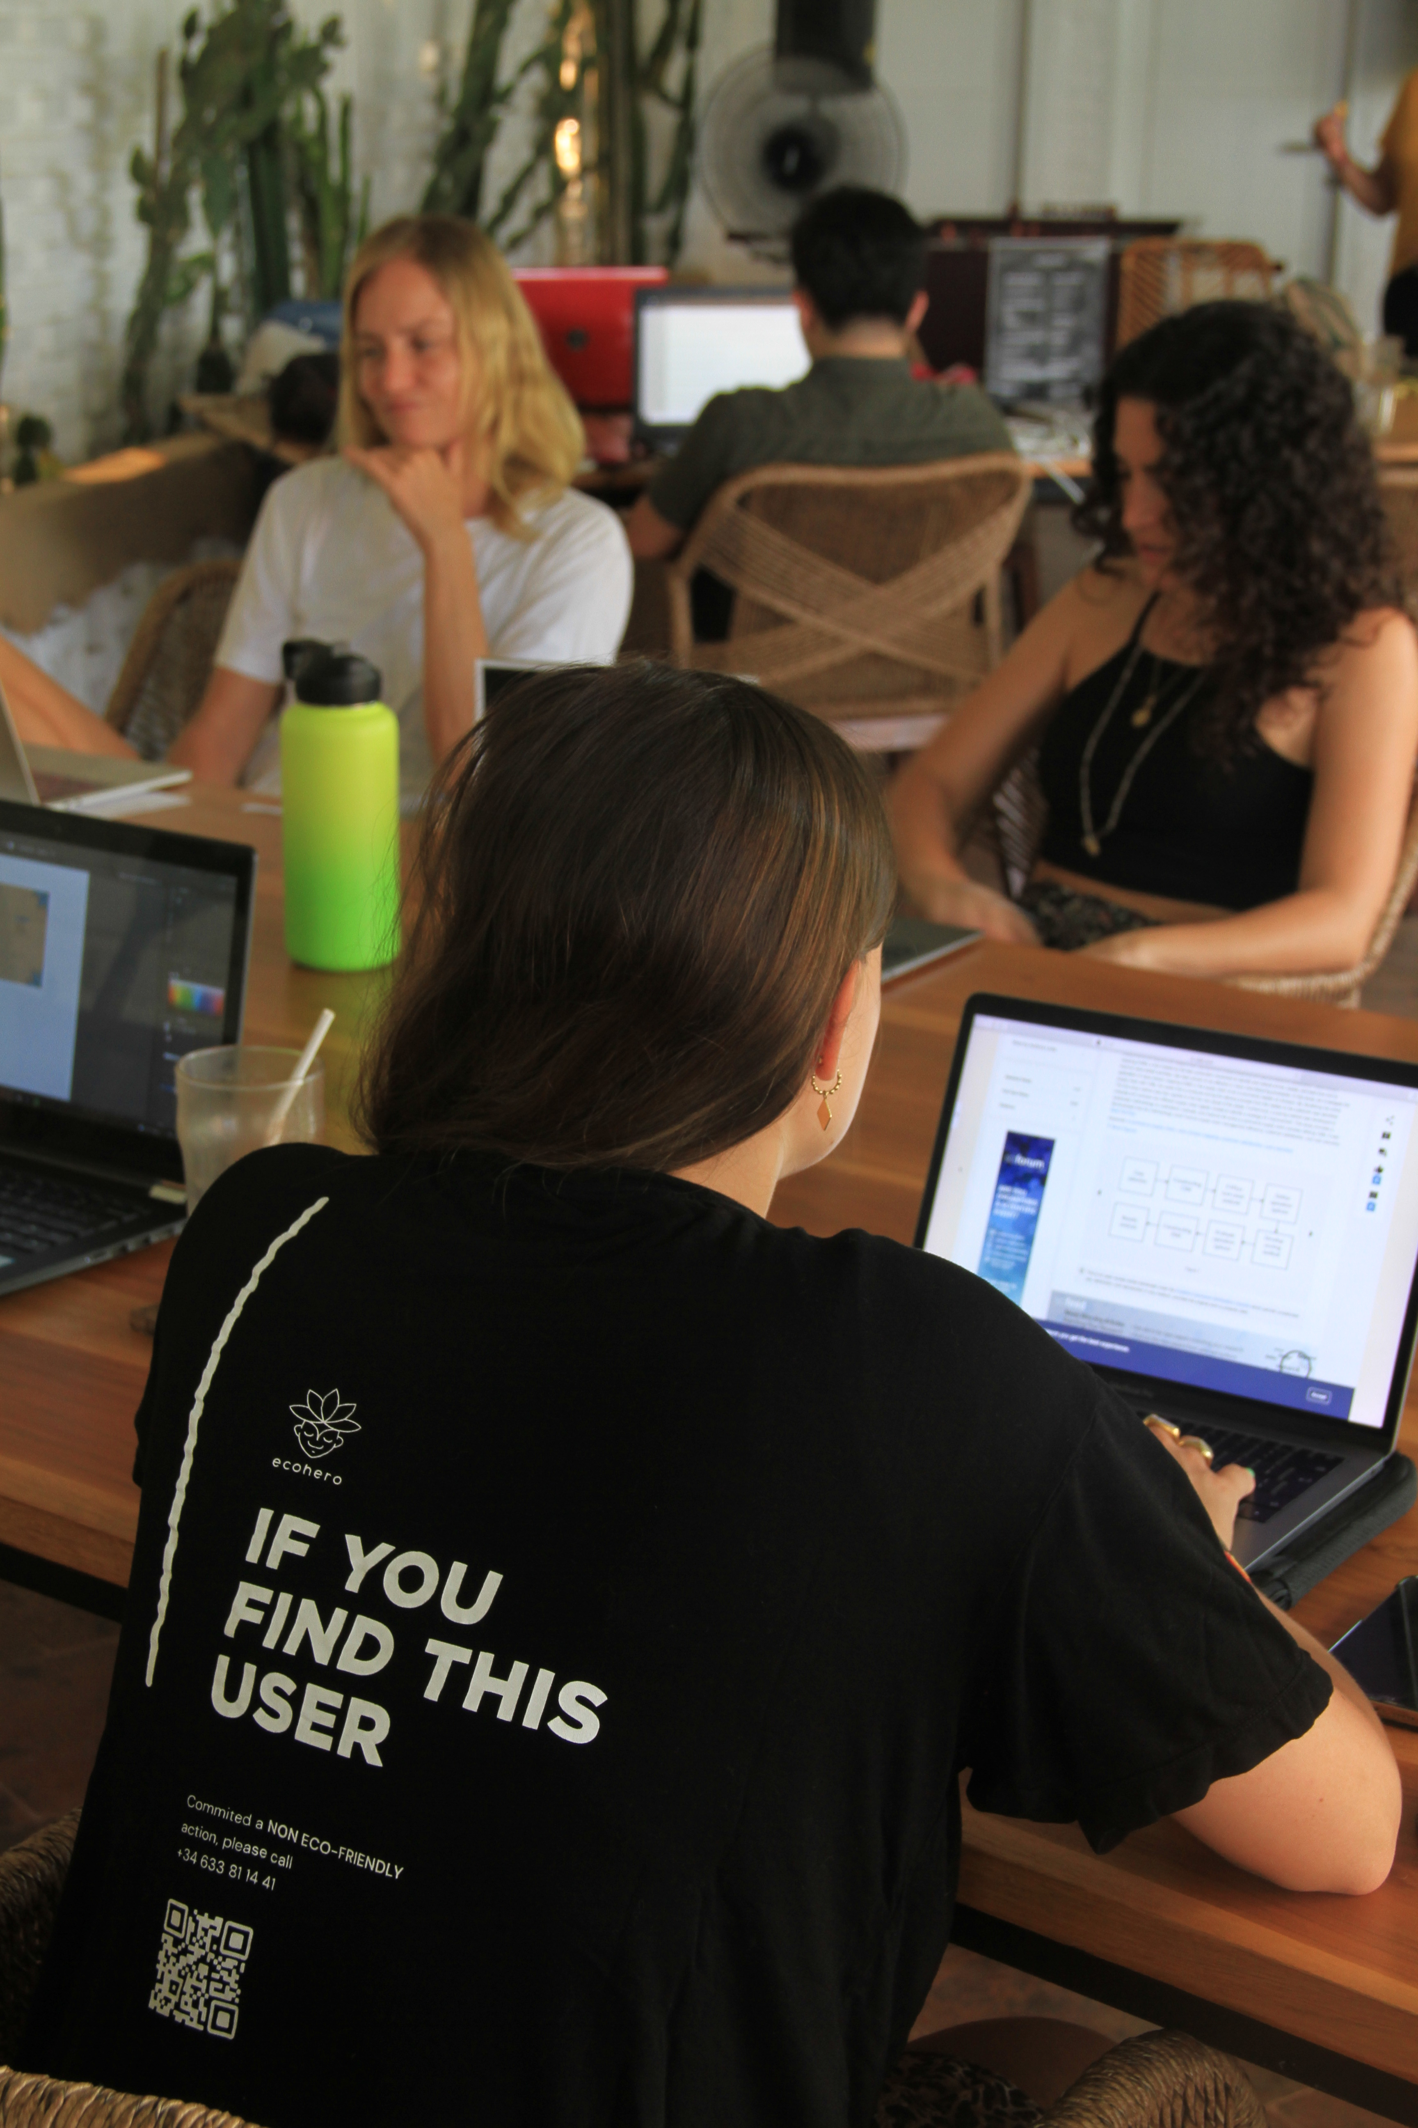
The research
What marketing strategy should the company follow to generate more sales through social media?
What is ecohero’s current strategy and what are the results of this?
What does the German market for sustainable products look like and who is the target group?
How can social media help ecohero to generate more sales with current internal capabilities?

Slide 7
Key findings
Current social media strategy is outdated
Instagram is their best performing platform
Germany offers an interesting marketing for ecohero
Target audience are mainly women between 23-40 years old with an interest in sustainability
Tested methods to improve performance: posting regular, stories, reels and using hashtags
Additional interesting methods to improve performance: influencer marketing, social media ads and an Instagram shop

Slide 8
Recommendations
Create new marketing strategy for German market
1
Perform a more extensive market research
2
Invest time and money in influencer marketing
3
Allocate a budget for ads on social media
4
Ad a social media shop
5

Slide 9
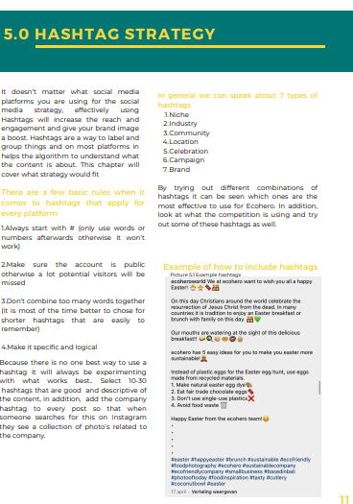
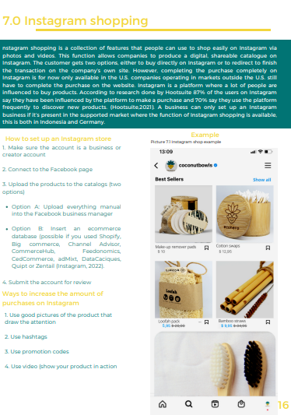
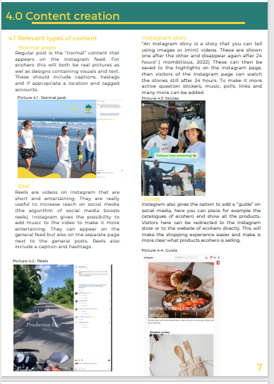
Professional product 1
New Instagram strategy

Slide 10
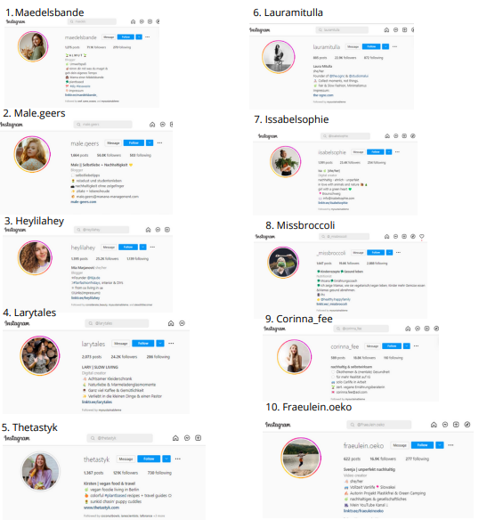
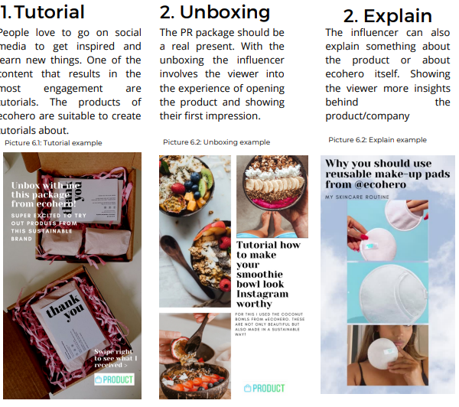
Professional product 2
Influencer marketing guide

Slide 11
SAFE
ecohero’s management found both the Instagram strategy and influencer guide are suitable to solve the problem. It’s already improving their performance on Instagram and both the investors as the management belief this will lead to new sales.
The time it takes to implement and see the results are acceptable for ecohero. In addition the (financial) risks are relatively low.
ecohero possesses the necessary internal capacities to carry out the plans within the professional product. Moreover, a new round of investments will provide sufficient capital to pay for this.

Slide 12
Conclusion
The study found that the current social media strategy needs to be adjusted if ecohero is to achieve better results on social media.
The recommendations can improve the performance on social media and help to increase the amount of sales made through these channels.
The management of ecohero is pleased with the professional products and is already working on the recommendations.

Slide 13
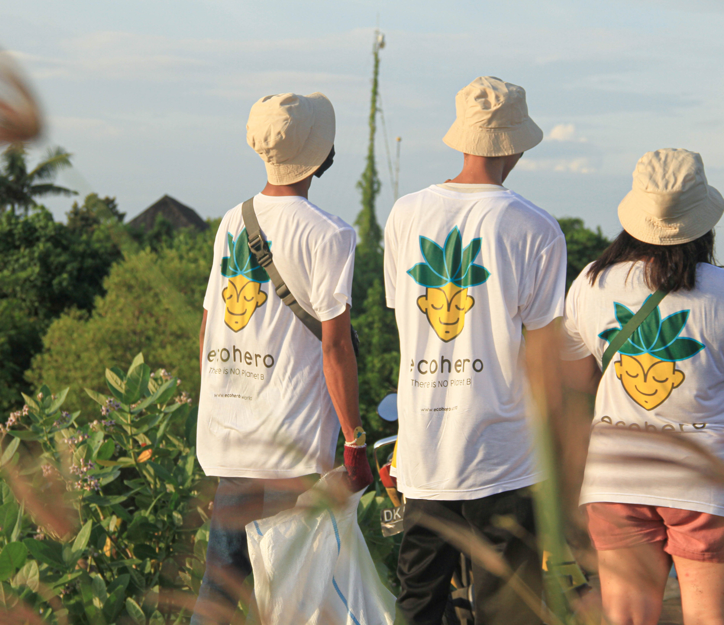
Thank you for listening
Kim Zwemer
Student Number: 78160
HZ University of Applied sciences
30 June 2022

