Slide 1
JULIA DRAGONE 00081074 15.06.2023
COURSE: INTERNATIONAL BUSINESS
HZ UNIVERSITY OF APPLIED SCIENCES
GRADUATION
PRESENTATION
THE POWER OF ENGAGEMENT: UNLEASHING IMPACT THROUGH THE SALES EXCELLENCE ONBOARDING

Slide 2
GOAL
ONBOARDING SALE EXCELLENCE PROGRAM
OPTIMISE IT

Slide 3
MAIN RESEARCH QUESTION
What actions can Air France KLM Martinair Cargo take to create an engaging onboarding process for the Sales Excellence Program to enhance its impact?
OPTIMISE IT

Slide 4
SATISFACTION
eNPS
-11.11
Data from March 2023

Slide 6
ISSUE
RECOMMENDATION
IMPLEMENTATION
NO OVERVIEW OF WHO NEEDED TO RECEIVE THE ONBOARDING
SENT TO MARKET MANAGERS
FILLED IN BY (INSIDE) SALES MANAGERS WHO NEEDED TO BE TRAINED
CREATE A FORM

Slide 8
ISSUE
RECOMMENDATION
IMPLEMENTATION
THEORETICAL
+
OUTDATED MATERIAL
CREATION OF 4 E-MODULES
CONDUCTION OF 2 (ONLINE) SESSIONS
MATERIAL HAS BEEN TESTED
INTRODUCE BLENDED LEARNING

Slide 9
STRUCTURE ONBOARDING
4 E-MODULES
2 WEEKS
4 LIVE SESSIONS
6-8 WEEKS
1 E-MODULE "RECAP"
1 E-MODULE “RECAP”

Slide 10
SESSION

Slide 11
E-MODULES

Slide 12
ISSUE
RECOMMENDATION
IMPLEMENTATION
LACK OF HANDS-ON EXAMPLES
INTRODUCE
BEST PRACTICES
SUBJECT EXPERTS IN BOTH LIVE SESSIONS & E-MODULES
CONCRETE EXAMPLES ON SALESFORCE

Slide 13
SESSION

Slide 14
ISSUE
RECOMMENDATION
IMPLEMENTATION
CHALLENGING
USE SEVERAL RESOURCES
INCLUDED PODCASTS, VIDEOS, GAMES & QUESTIONS
CREATED AN INTERACTIVE ENVIRONMENT

Slide 17
ISSUE
RECOMMENDATION
IMPLEMENTATION
THE PERCEPTION OF THE ONBOARDING PROCESS WAS UNKNOWN
CREATE AN EVALUATION FORM
SENT IT TO ATTENDEES
CONSIDERED FEEDBACK FOR NEXT ONBOARDING

Slide 19
SUITABLE
RESOURCES, PEOPLE & CAPABILITIES
Air France KLM Martinair Cargo has all the resources, people and capabilities needed to provide a structured engaging onboarding.
1
LEARNING PROCESS IS MORE EFFECTIVE
2
An engaging training program captures the attention and interest of sales managers and inside sales, making the learning process more effective.
BLENDED LEARNING
3
Based on research, blended learning is the most effective teaching method. In addition, it is the most preferred option for sales managers and inside sales.
BETTER UNDERSTANDING
4
Attendees can better understand how to use the skills and knowledge acquired by actively participating in discussions and applying what learned on Salesforce.

Slide 20
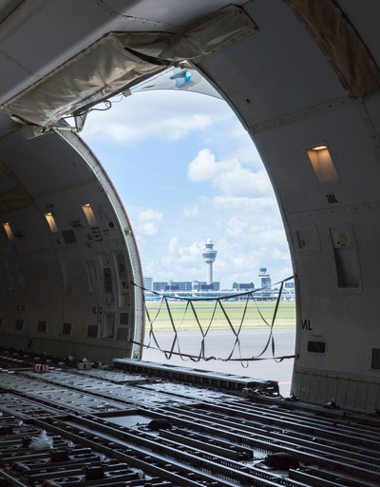
ACCEPTABLE
It addresses the areas that needed improvement, taking into account the feedback received from sales managers and inside sales.
PROBLEM | SOLUTION
Theoretical + outdated material | The theory has been reduced and provided using several tools (games, podcasts, videos..)
Not engaging | Live sessions are interactive and allow discussions between attendees and subject expert/facilitator.
The reason why this program should be taught was missing | The first module (both e-learning and live session) is dedicated to the "why" of Sales Excellence.
No track of who needs to receive the onboarding | Creation of a form that new sales managers and inside sales should fill in to sign up for the onboarding.

Slide 21
FEASIBLE
Notes:
Mention that the cost is not a lot of flight as they have discounts as it is for the company

Slide 22
FEASIBLE
1
€ 1
Invested in L&D per employee
€ 2,898
Additional revenue per employee
ROI
ROI (%) = ((Monetary benefit – Training Cost)/Training Cost) x 100
2
Training cost/year= 81.754,00 €
Monetary benefit: 81.754*2,898= 236.923,092 €
189,8%
1. https://www2.deloitte.com/content/dam/Deloitte/global/Documents/About-Deloitte/about-deloitte-global-report-full-version-2020.pdf
2. https://www.linkedin.com/pulse/calculating-roi-employee-training-development-philip-seely/

Slide 23
THE BEST PROOF IS....
THESE RECOMMENDATIONS HAVE BEEN ACCEPTED AND IMPLEMENTED

Slide 24
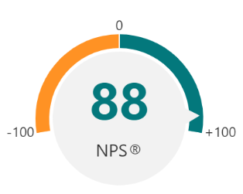
eNPS
MARCH 2023
EXPECTATION
JUNE 2023
...The aim is to improve the eNPS score from
-11.11 (current eNPS) to above 20.

Slide 25
FEEDBACK ATTENDEES
Julia was enthusiastic and I did not feel stupid when asking questions
I really liked that why Sales Excellence is needed was included and how actually it is used in real life by sales managers
The program was efficiently organized with valuable insights of experts as well as clear theoretical framework

Slide 26
FEEDBACK ATTENDEES

Slide 27
EXTERNAL FEEDBACK

Slide 28
DYNAMIC
STATIC

Slide 29
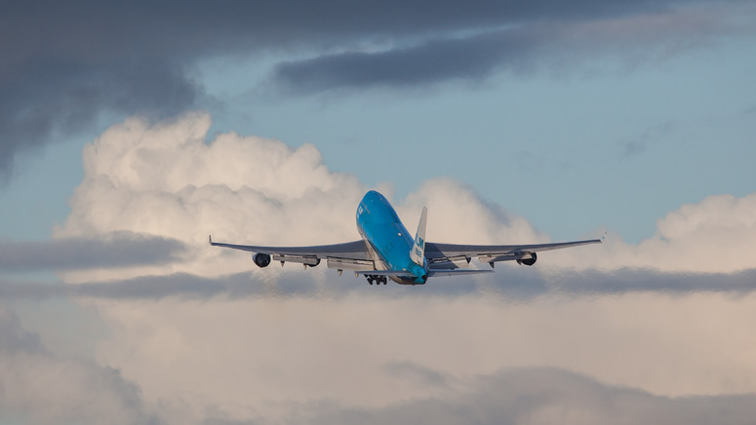
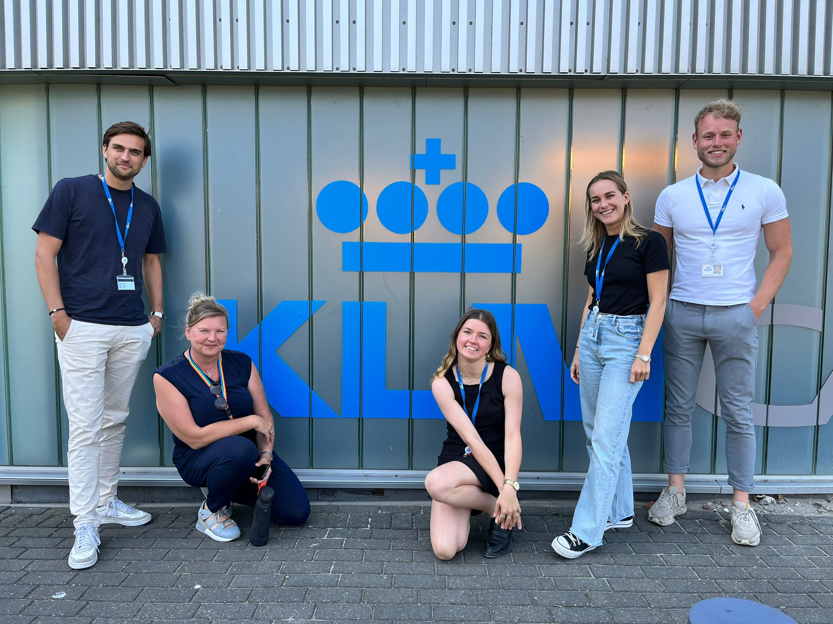
THANK YOU FOR YOUR ATTENTION!
Julia Dragone - drag0005@hz.nl
Graduation presentation

