Slide 1


Exploring e-commerce expansion opportunities
Graduation Internship at Maxodeals
Richard van der Putten – 00081140
Graduation Supervisor: Mr. García Sepulvéda | In-Company Supervisor: Nicole Gielen

Slide 2

Contents of this presentation
The company
The problem
Advices 1-5
Implementation / SAFe
Professional Product

Slide 3
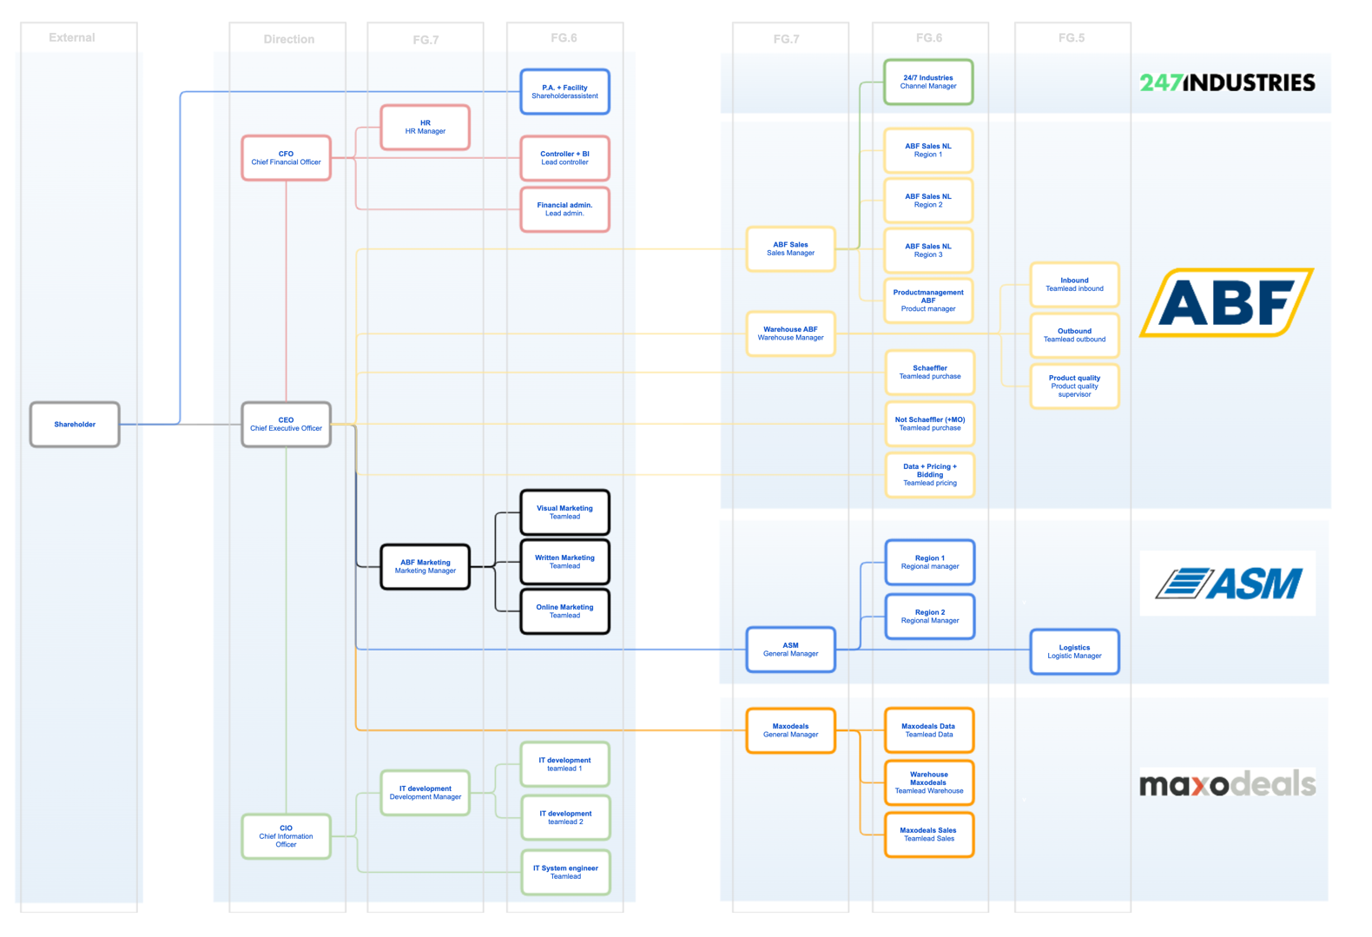
The company

Slide 4
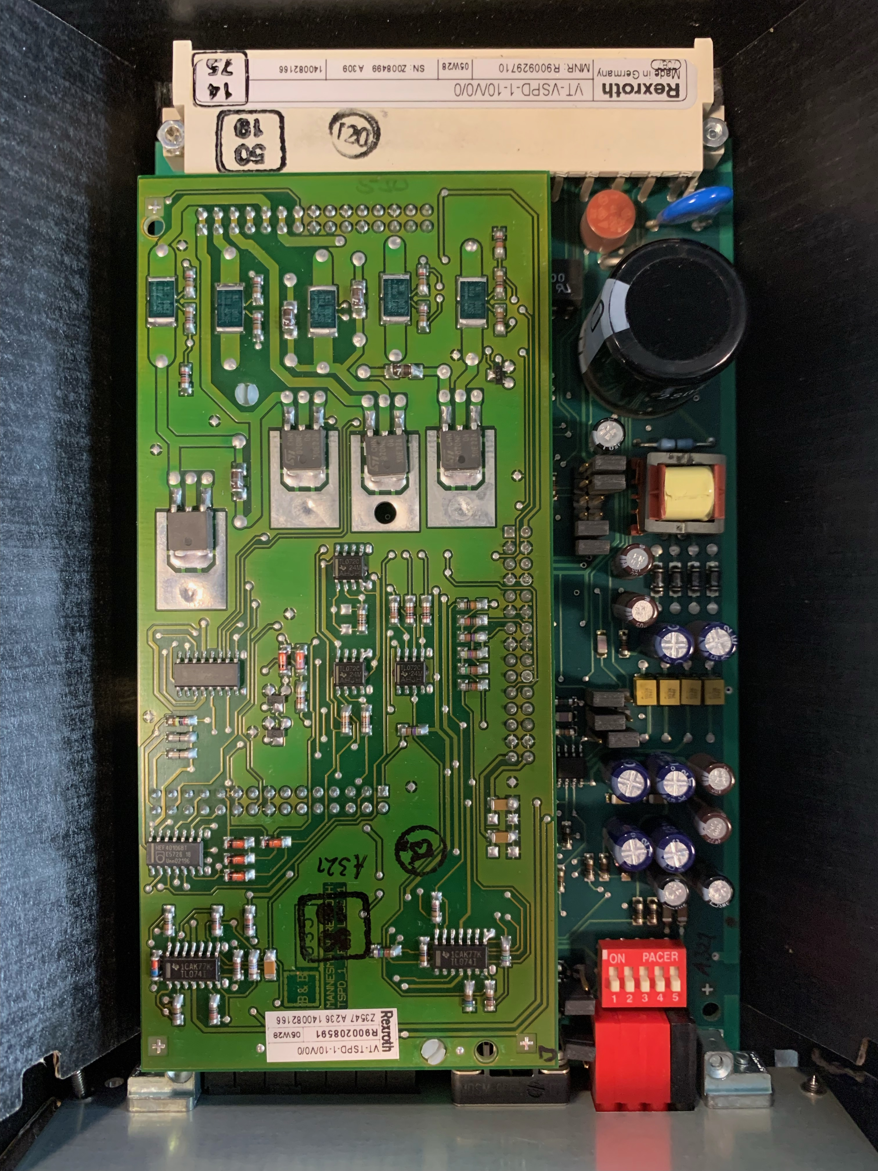


The problem
Marketplaces
Maxodeals.com
eBay
Amazon
Web shop that runs on Magento
Serves as the source of product information
International shipment on .de and .com
Worldwide shipment
Active on local eBay sites
Active on local Amazon sites
Research question:
Resources
Sub questions:
Marketplace
Processes

Slide 5

Recommendations
Marketplace selection
Other marketplaces
Magento
Magento – performance
Feedback from customers

Slide 6
Marketplace selection model ~ Prefilter
Based on the Filter model by Leeman, a model for export planning
Criteria ranked on importance, from a PESTLE Analysis and observations.
Walmart & Mercado Libre

Slide 7
Marketplace selection model ~ Filter 1
Cdiscount
Bol.com
Amazon Japan

Slide 8

Marketplace selection model ~ Filter 2
Cdiscount

Slide 9

Information:
Third most popular eCommerce platform in France
Allowed to sell used items
Commission 15-17% per order (includes shipment)
€39,99 per month
Automation category not fully developed yet
Points of attention:
Product information in French
Use of EANs

Slide 10
Necessary documents:
  Identity documents of the company manager:
    Front and back of the ID
  Official legal company registration:
    In English and not older than 3 months
  Official bank information:
    In English and not older than 3 months

Slide 11


Other marketplaces
2nd and 3rd in the Marketplace Selection Model
*Further research is necessary

Slide 12


Magento
Should be a requirement for new marketplaces, because of the otherwise increased workload
A Magento plugin for Cdiscount by Cedcommerce is available

Slide 13


Magento performance
In the long-term, an ”intermediary” will be required to prevent slowdowns of the system.

Slide 14

Feedback from the customer
Potential yield:
Information about smaller, but more suitable “local” marketplaces like Allegro in Poland
Customers previously not reached
Not before noted preferences and experiences
How?
Surveys and feedback forms
Include in the different ways of customer contact (Calls, Emails, Chats, etc….)

Slide 15
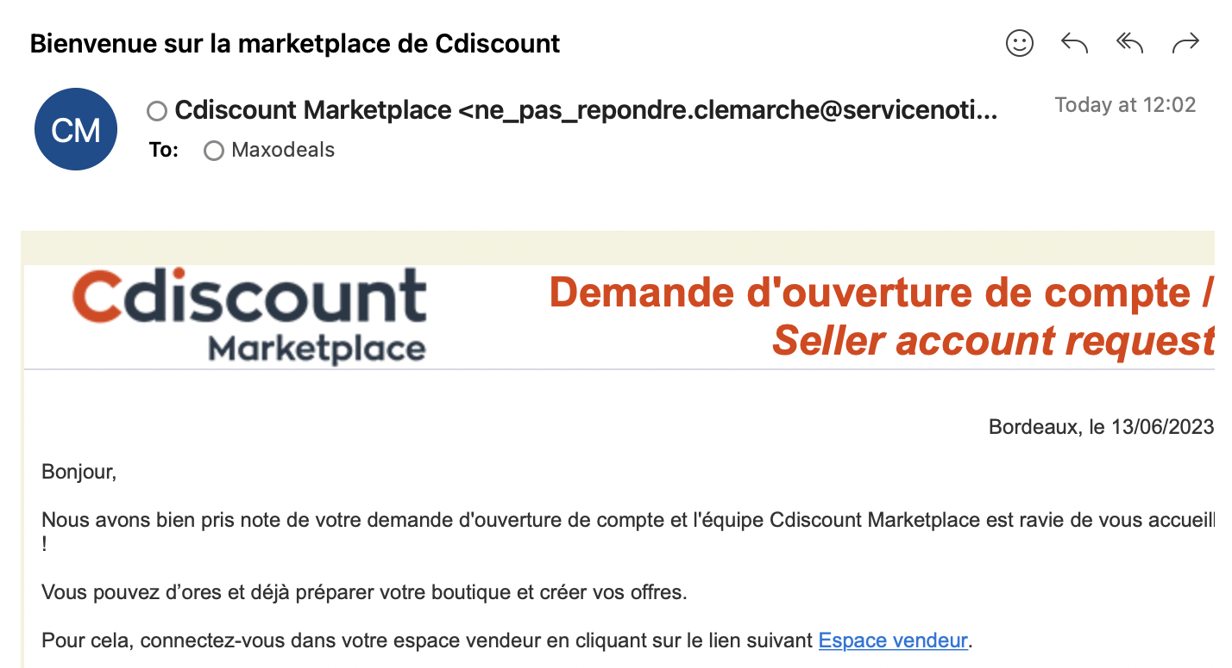
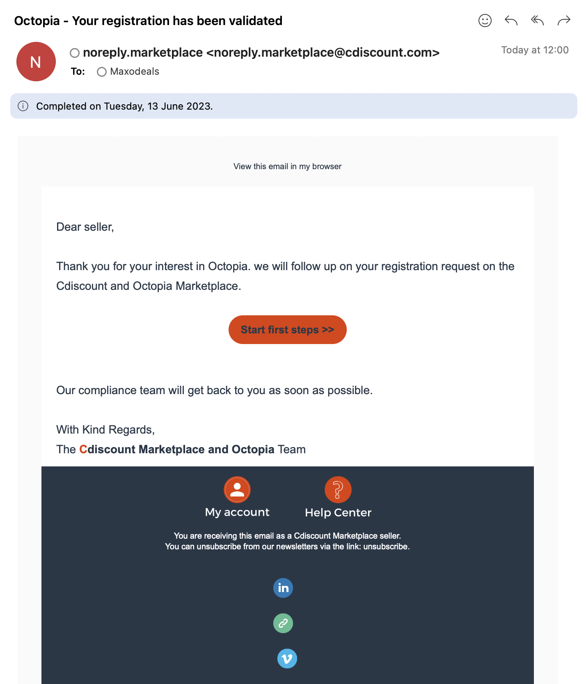
Implementation
“Allegro.pl apparently does not want us on their website, let’s start implementing the points from this advice immediately.” – Jordy Grimminck, General Manager at Maxodeals

Slide 16


Advice report
(Includes the implementation plan)

Slide 17
References
Maxodeals. (n.d.-a). About Us. https://www.maxodeals.com/about-us
Maxodeals. (n.d.-b). Team. https://www.maxodeals.com/team
Van Der Putten, R. (2023a). Exploring e-commerce expansion opportunities - research justification.
Van Der Putten, R. (2023b). Exploring eCommerce expansion opportunities: An advice report.

