Slide 1
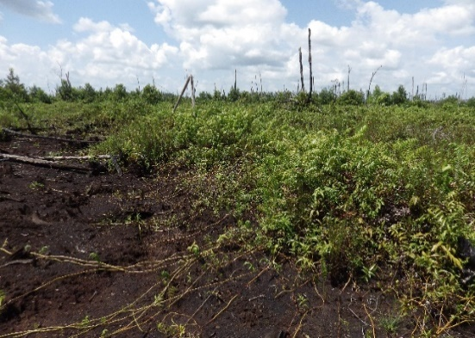
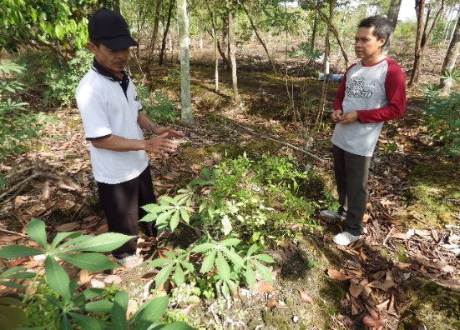
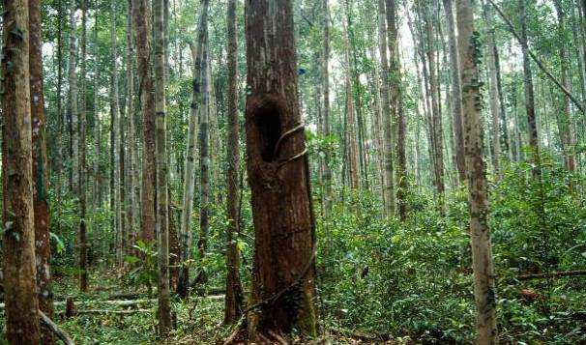
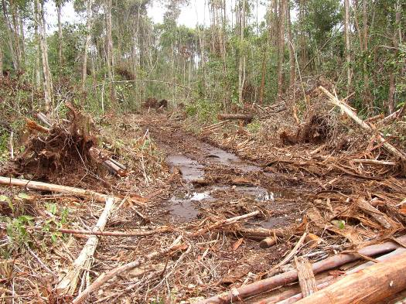
Historical data guides restoration of degraded peat swamp forests
INAFOR September 7, 2021
Jannes van Hoeflaken
Peter van der Meer
Malcom Demies

Slide 2
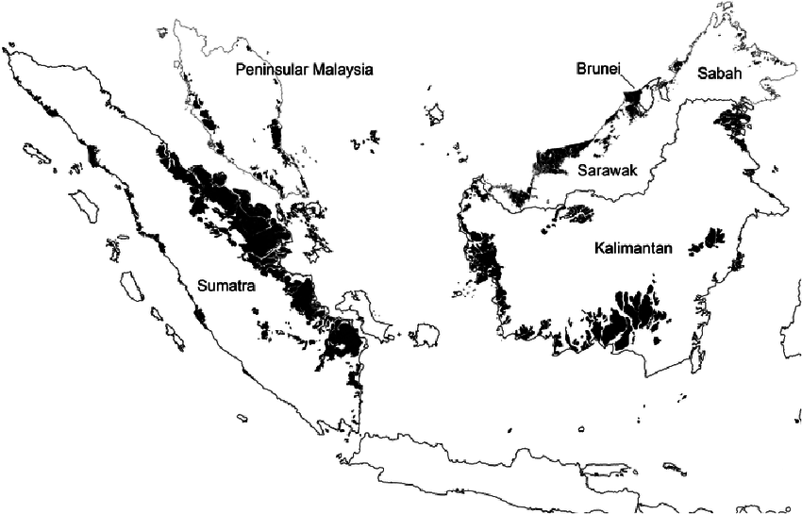
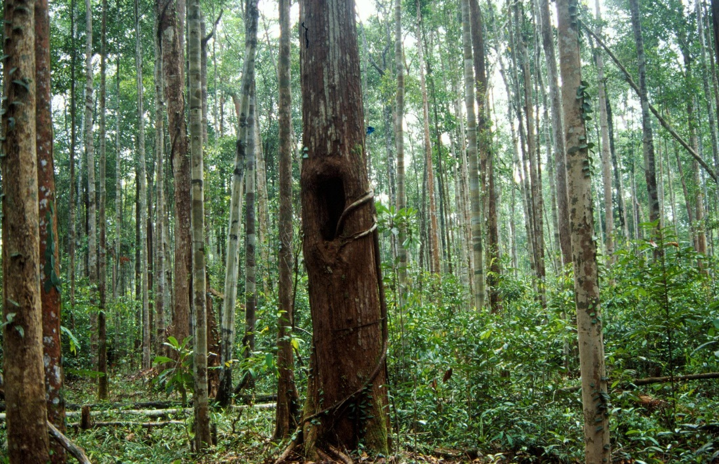
Introduction – Peat Swamp Forests (PSF)
PSF is a major forest type in Indonesia and Malaysia
But: most areas are highly degraded
The challenge now is to restore degraded PSF to intact ecosystems
Extend of peat swamp forest in Malaysia and western Indonesia by Posa et al. (2011)
Main Question:
How does intact PSF look like?

Slide 3
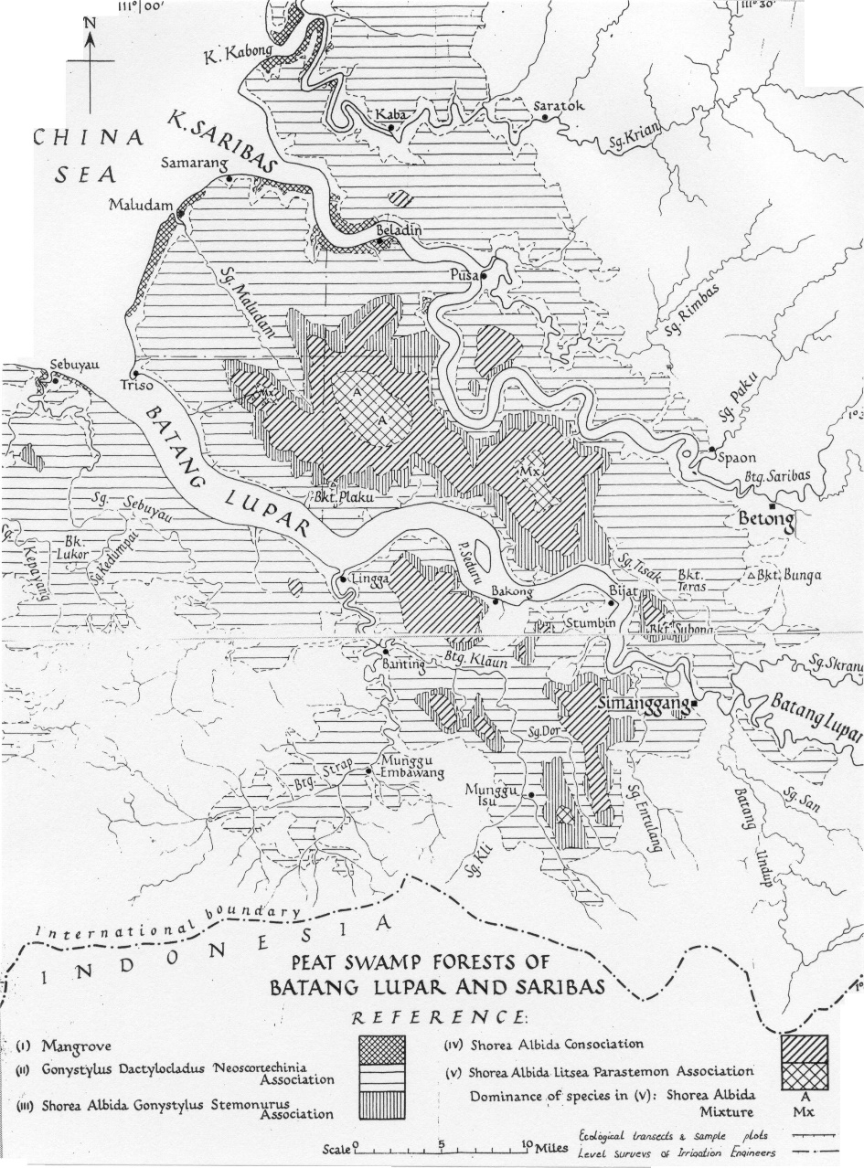
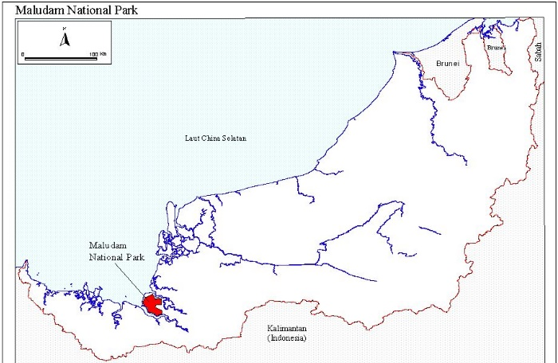
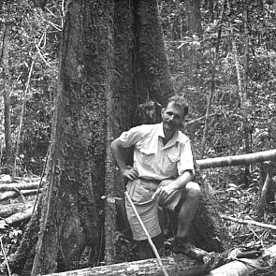
Peat Dome and associated forest types – Sarawak
J. A. R. Anderson at the base of large PSF tree (possibly Shorea albida)
Peat dome and associated forest types on Maludam peninsula, Sarawak, Malaysia (Anderson, 1961).
Anderson measured 53 plots covering 10.6 ha of pristine PSF, and described phasic communities within the forest

Slide 4
Background: Interdependency of peat and forest
PSF Vegetation types are related to moisture and nutrients
PC1 Mixed swamp forest
PC2 Alan forest
PC3 Alan bunga forest
PC4 Padang alan forest
PC5 Tristania- Parastemon-Palaquium association
PC6 Padang keruntum
PC6
PC5
PC4
PC3
PC2
PC1
After Anderson, 1961

Slide 5
Methods
Using Anderson’s data as reference values for pristine peat swamp forest
We compare the pristine PSF values with the current situation in Sarawak PSF, by looking at:
  General forest structure
  3 tree species: - Ramin (Gonystylus bancanus)
              - Jongkong (Dactylocladus stenostachys)
              - Alan (Shorea albida)

Slide 6
Results: reference values
Forest structure in intact PSF, for all six phasic communities, as Anderson (1961) described:
Phasic community | No. of species | Stems ≥10 cm ha⁻¹ | Canopy height (m) | Peat depth (main range, in m)
PC1 | 129 | 630 | 30-43 | 0-5 (but also found at > 10)
PC2 | 136 | 642 | 30-46 | 5-8
PC3 | 41 | 506 | 46-58 | 8-10
PC4 | 45 | 711 | 30-37 | 10-12
PC5 | 19 | 1280 | 15-22 | 12-14
PC6 | 6 | - | 2-12 | >14

Slide 7
Historic data: stem density in PSF (Anderson 1961)

Slide 8
Historic data: stem density Ramin
Rather common in all phasic communities (except 6)
Tree size progressively reduces with advancing phasic community
Large trees are only found in PC 1 and 2

Slide 9
Historic data: stem density Jongkong & Alan
D. stenostachys
S. albida
Very abundant in PC5
Large trees are only found in PC1 and 2
Only tree found in all PC’s (also in PC6)
Extremely abundant in PC3 and 4
Dominates the canopy in PC2, but other species are also present

Slide 10
Comparison with current situation: Maludam
PC1: Ramin and Jongkong were both recorded only once
Forest structure very different from intact forest
Large trees are absent

Slide 11
Comparison with current situation: Ever Herald
PC3
PC4
Species (≥10 cm DBH) | PC3 |  | PC4
 | Anderson | Ever Herald | Anderson | Ever Herald
All species ha⁻¹ | 506 | 584 | 711 | 1312
Dactylocladus stenostachys ha⁻¹ | 15.4 | 68 | 41.6 | 52
Gonystylus bancanus ha⁻¹ | 48.2 | 0 | 25.5 | 4
Shorea albida ha⁻¹ | 140.8 | 188 | 250.7 | 876

Slide 12
Prospects for rehabilitation
Ramin: natural regeneration is problematic; enrichment plantings might be needed to achieve healthy populations, but site must be carefully assessed since Ramin requires partial shade
Jongkong: has faced a strong population decline, but due to jongkong’s pioneer characteristics it could be a very interesting species for PSF rehabilitation (in open areas)
Alan: can regenerate prolific if conditions are right; natural densities could also be restored by planting if natural regeneration is not possible, but is only native to a restricted area

Slide 13
Conclusion/lessons learned
Current populations structure of ramin, jongkong and alan is highly disturbed
Historical population values have a much greater abundance of large trees
Restoring population structure of important species can be seen as goal for rehabilitation measures
Restoring the peat hydrology is paramount!
Final target is to restore ecosystem functioning, including carbon sequestration, biodiversity conservation, and possibly timber production.

Slide 14

Thank you for your attention

