Slide 1
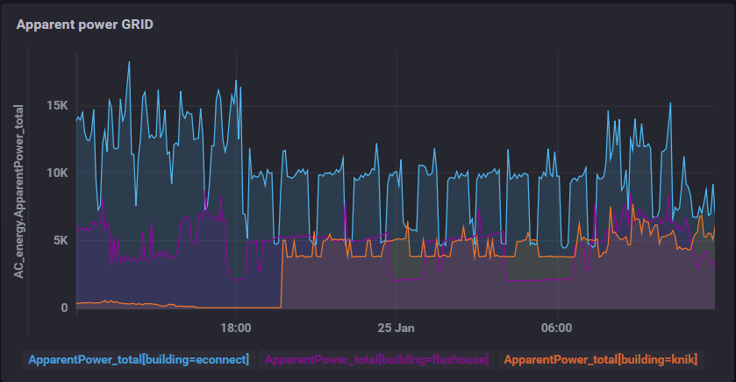
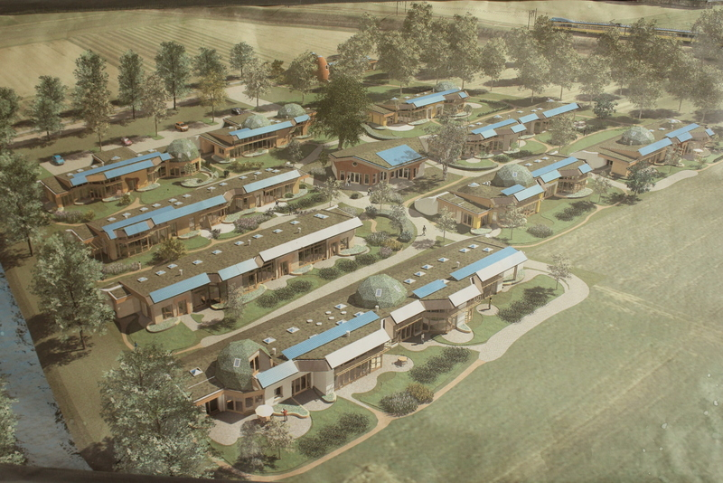
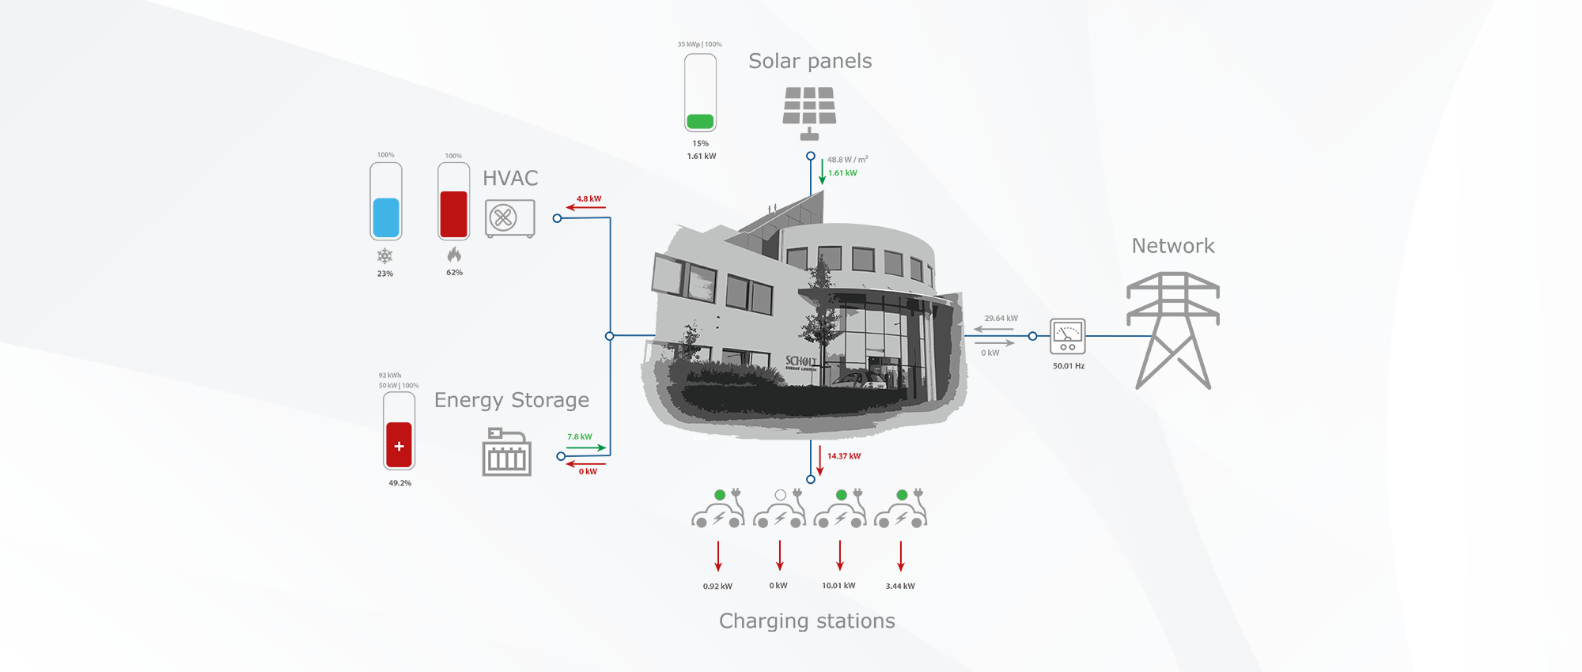
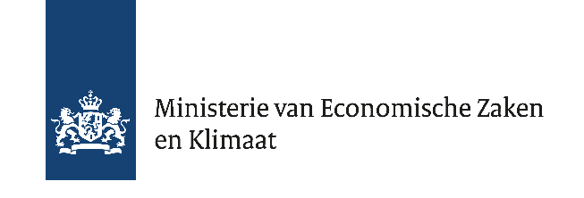
231
Batteries in the energy transition
A cross-border use case from the
Rhine-Waal region
A. Masolin¹, E. Schaefer², S. McDermot³, H. Bühler⁴
1. University of Applied Science Zuyd, The Netherlands
2. University of Applied Sciences Saxion, The Netherlands
3. Scholt Energy Services, The Netherlands
4. Kiemt, The Netherlands
The built environment accounts for approximately 30-40% of the total energy consumption in the Netherlands and Germany (RVO, 2015). The INTERREG project Cleantech Energy Crossing therefore aims to facilitate the energy transition in this area by promoting cross-border collaboration. Through the realization of various innovations and new technological products, this project wants to make an important contribution in achieving the climate targets of the Netherlands (-20% CO₂ emissions to 2020) and North Rhine-Westphalia (-25% CO₂ emissions to 2020).
In the built environment, decentralized energy is increasingly being generated, for example by means of solar panels. Not all solar energy that is generated is directly used: on average, one-third is immediately used, while two-thirds are returned to the grid. By storing electrical energy in the home with small-scale battery technology, your own energy consumption can be doubled.
Within Cleantech Energy Crossing, therefore, various Dutch and German SMEs and research institutes are working together on the (continued) development of innovative stationary battery technologies (5-10 kWh) in order to increase the storage capacity and the percentage of self-consumption of home-produced electricity in homes. This is done while maintaining a connection to the electricity grid, not by pursuing completely off-road autarchy.
The research group of Sustainable Built Environment at Zuyd University of Applied Science developed an acquisition system capable to acquire with extreme accuracy and frequency data from several hundreds of sensors sparse in all the district. A dashboard is developed to ease the task of data visualization for the partners, for the researchers and the students as well.
The research group of Sustainable Energy Systems at Saxion University of Applied Sciences, in cooperation with the Association Aardehuizen in Olst, are working on the integration of a centralized battery system in a neighborhood of 24 homes. Each home is a so called Earthship, a house built with sustainability and low energy usage in mind. The goal of the association Aardehuizen is to be as self-sufficient as possible.
- Create Smart Grid with different assets (PV, EV-chargers, batteries, ...).
- Optimize the autarchy to enable a green system through sustainable assets in combination with energy carriers.
- Use flexibility of assets to balance the grid, decrease energy costs by peak shaving or trade on the energy markets.
- Create more redundancy in the system by adding multiple flexible assets which can cover downtime.
Kiemt is the lead partner of the INTERREG project Cleantech Energy Crossing In a consortium of more than 30 Dutch and German partners.
Kiemt coordinates the different working packages, supports the project partners in achieving their goals and facilitates and promotes cross-border collaboration and dissemination of knowledge.
The aim of WP3 is the development, demonstration and analysis of two innovative batteries (‘sea salt battery’ of Dr Ten and ‘hydrogen bromine flow battery’ of Elestor) in a micro-grid setting.
Supported by:

