Slide 1
ASSOCIATIVE LEARNING IN ASD
Mick de Koning
Badura Lab

Slide 2
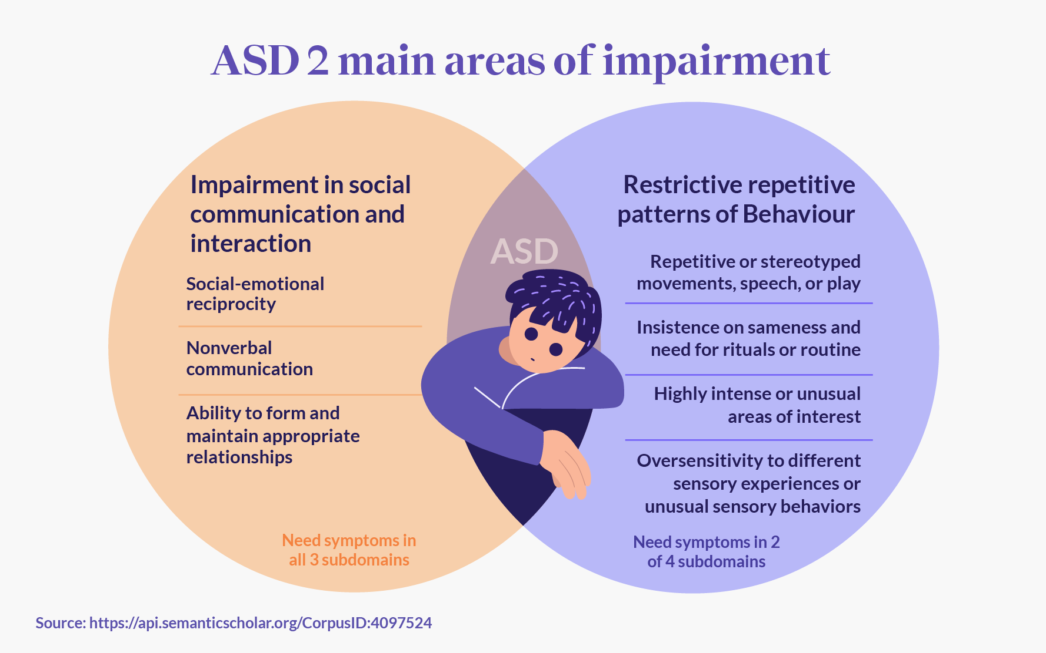
Background ASD
- Neurodevelopmental disorder
- Impaired social cognition
- Repetitive behaviour
- Atypical information processing
- 1% prevalence
- Genetic component
- Cerebellar involvement

Slide 3
Shank2 protein in ASD
- Risk gene in ASD
- Autism like phenotype in mice
- Hyperactivity
- Abnormal social behaviour
- Impaired learning Saša Peter et al.
Notes:
Postsynaptic Scaffolding protein

Slide 4
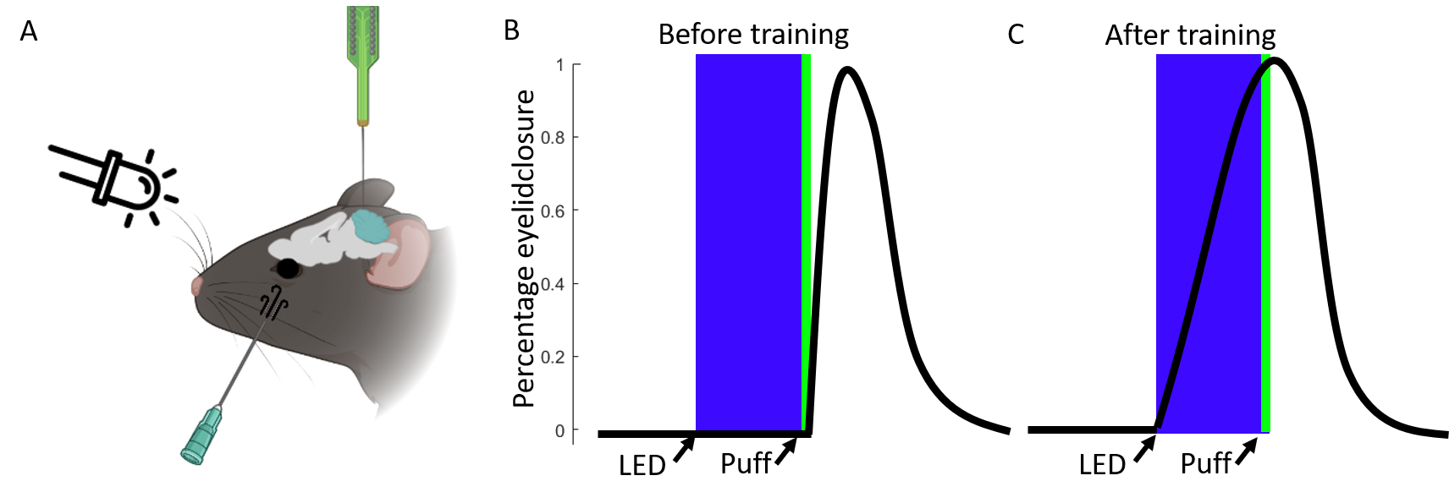
Eyeblink conditioning
- Associative learning
- Pavlovian conditioning
- Conditioned stimulus(CS)
- Unconditioned stimulus (US)
- Highly cerebellar dependent

Slide 5
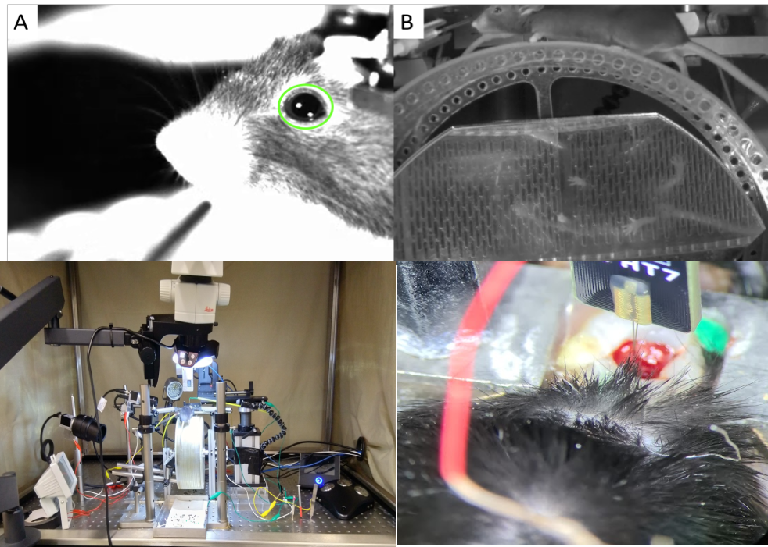
Experimental setup
- Head fixed wheel
- Video recording
- Electrophysiology setup

Slide 6
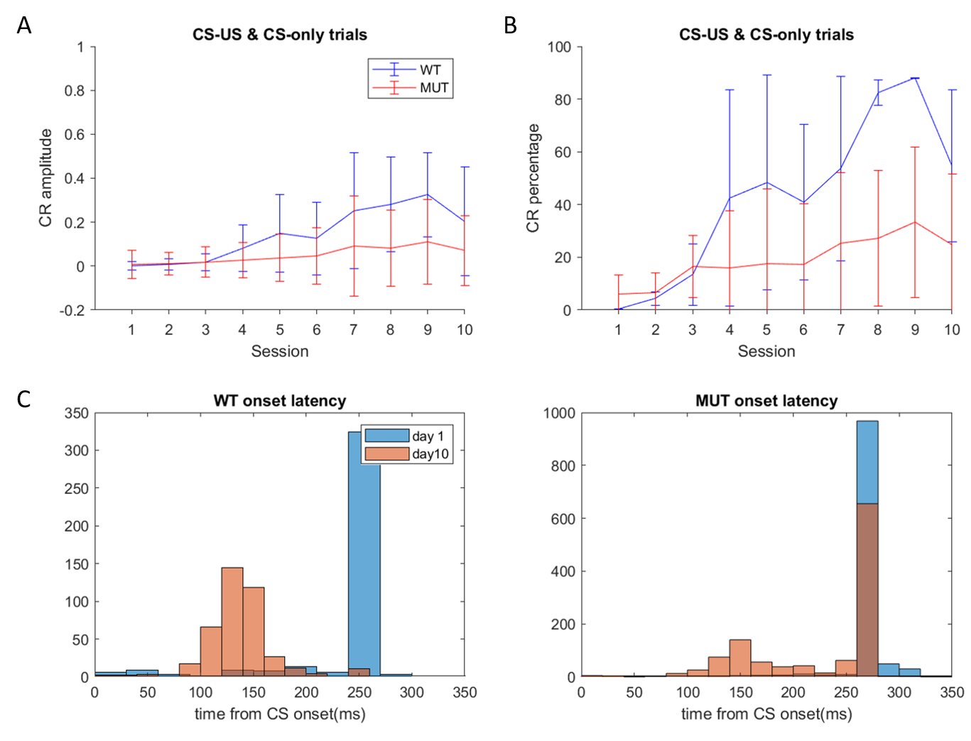

Slide 7
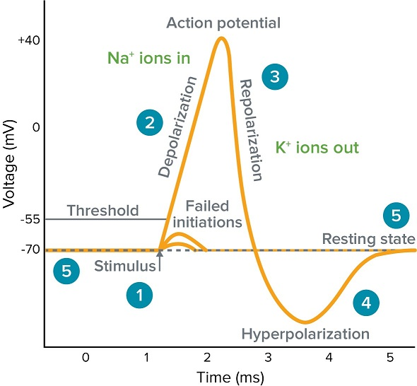
Extracellular electrophysiology
- Record Action potential
- Single unit activity

Slide 8
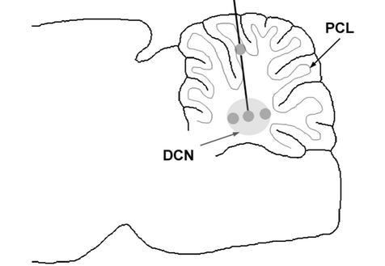
Extracellular electrophysiology
- Deep cerebellar nuclei (DCN)
- Complex spiking purkinje cells
- Sole output of cerebellum

Slide 9
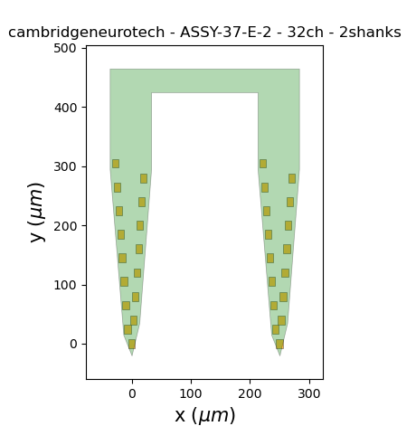
Spike sorting
- Separate into single cell data
- Large amount of data
- Choice spike-sorter

Slide 10
Ironclust spike sorting pipeline
- Filter out noise
- Spike detection
- Manual curation:
60µv peak
Single unit
Stability trough recording
No complex spikes in recording

Slide 11
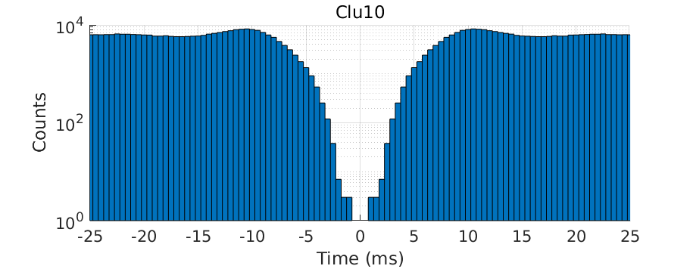

Slide 12
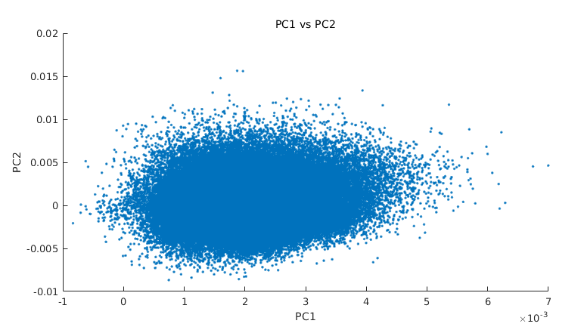

Slide 13
Recording quality

Slide 14
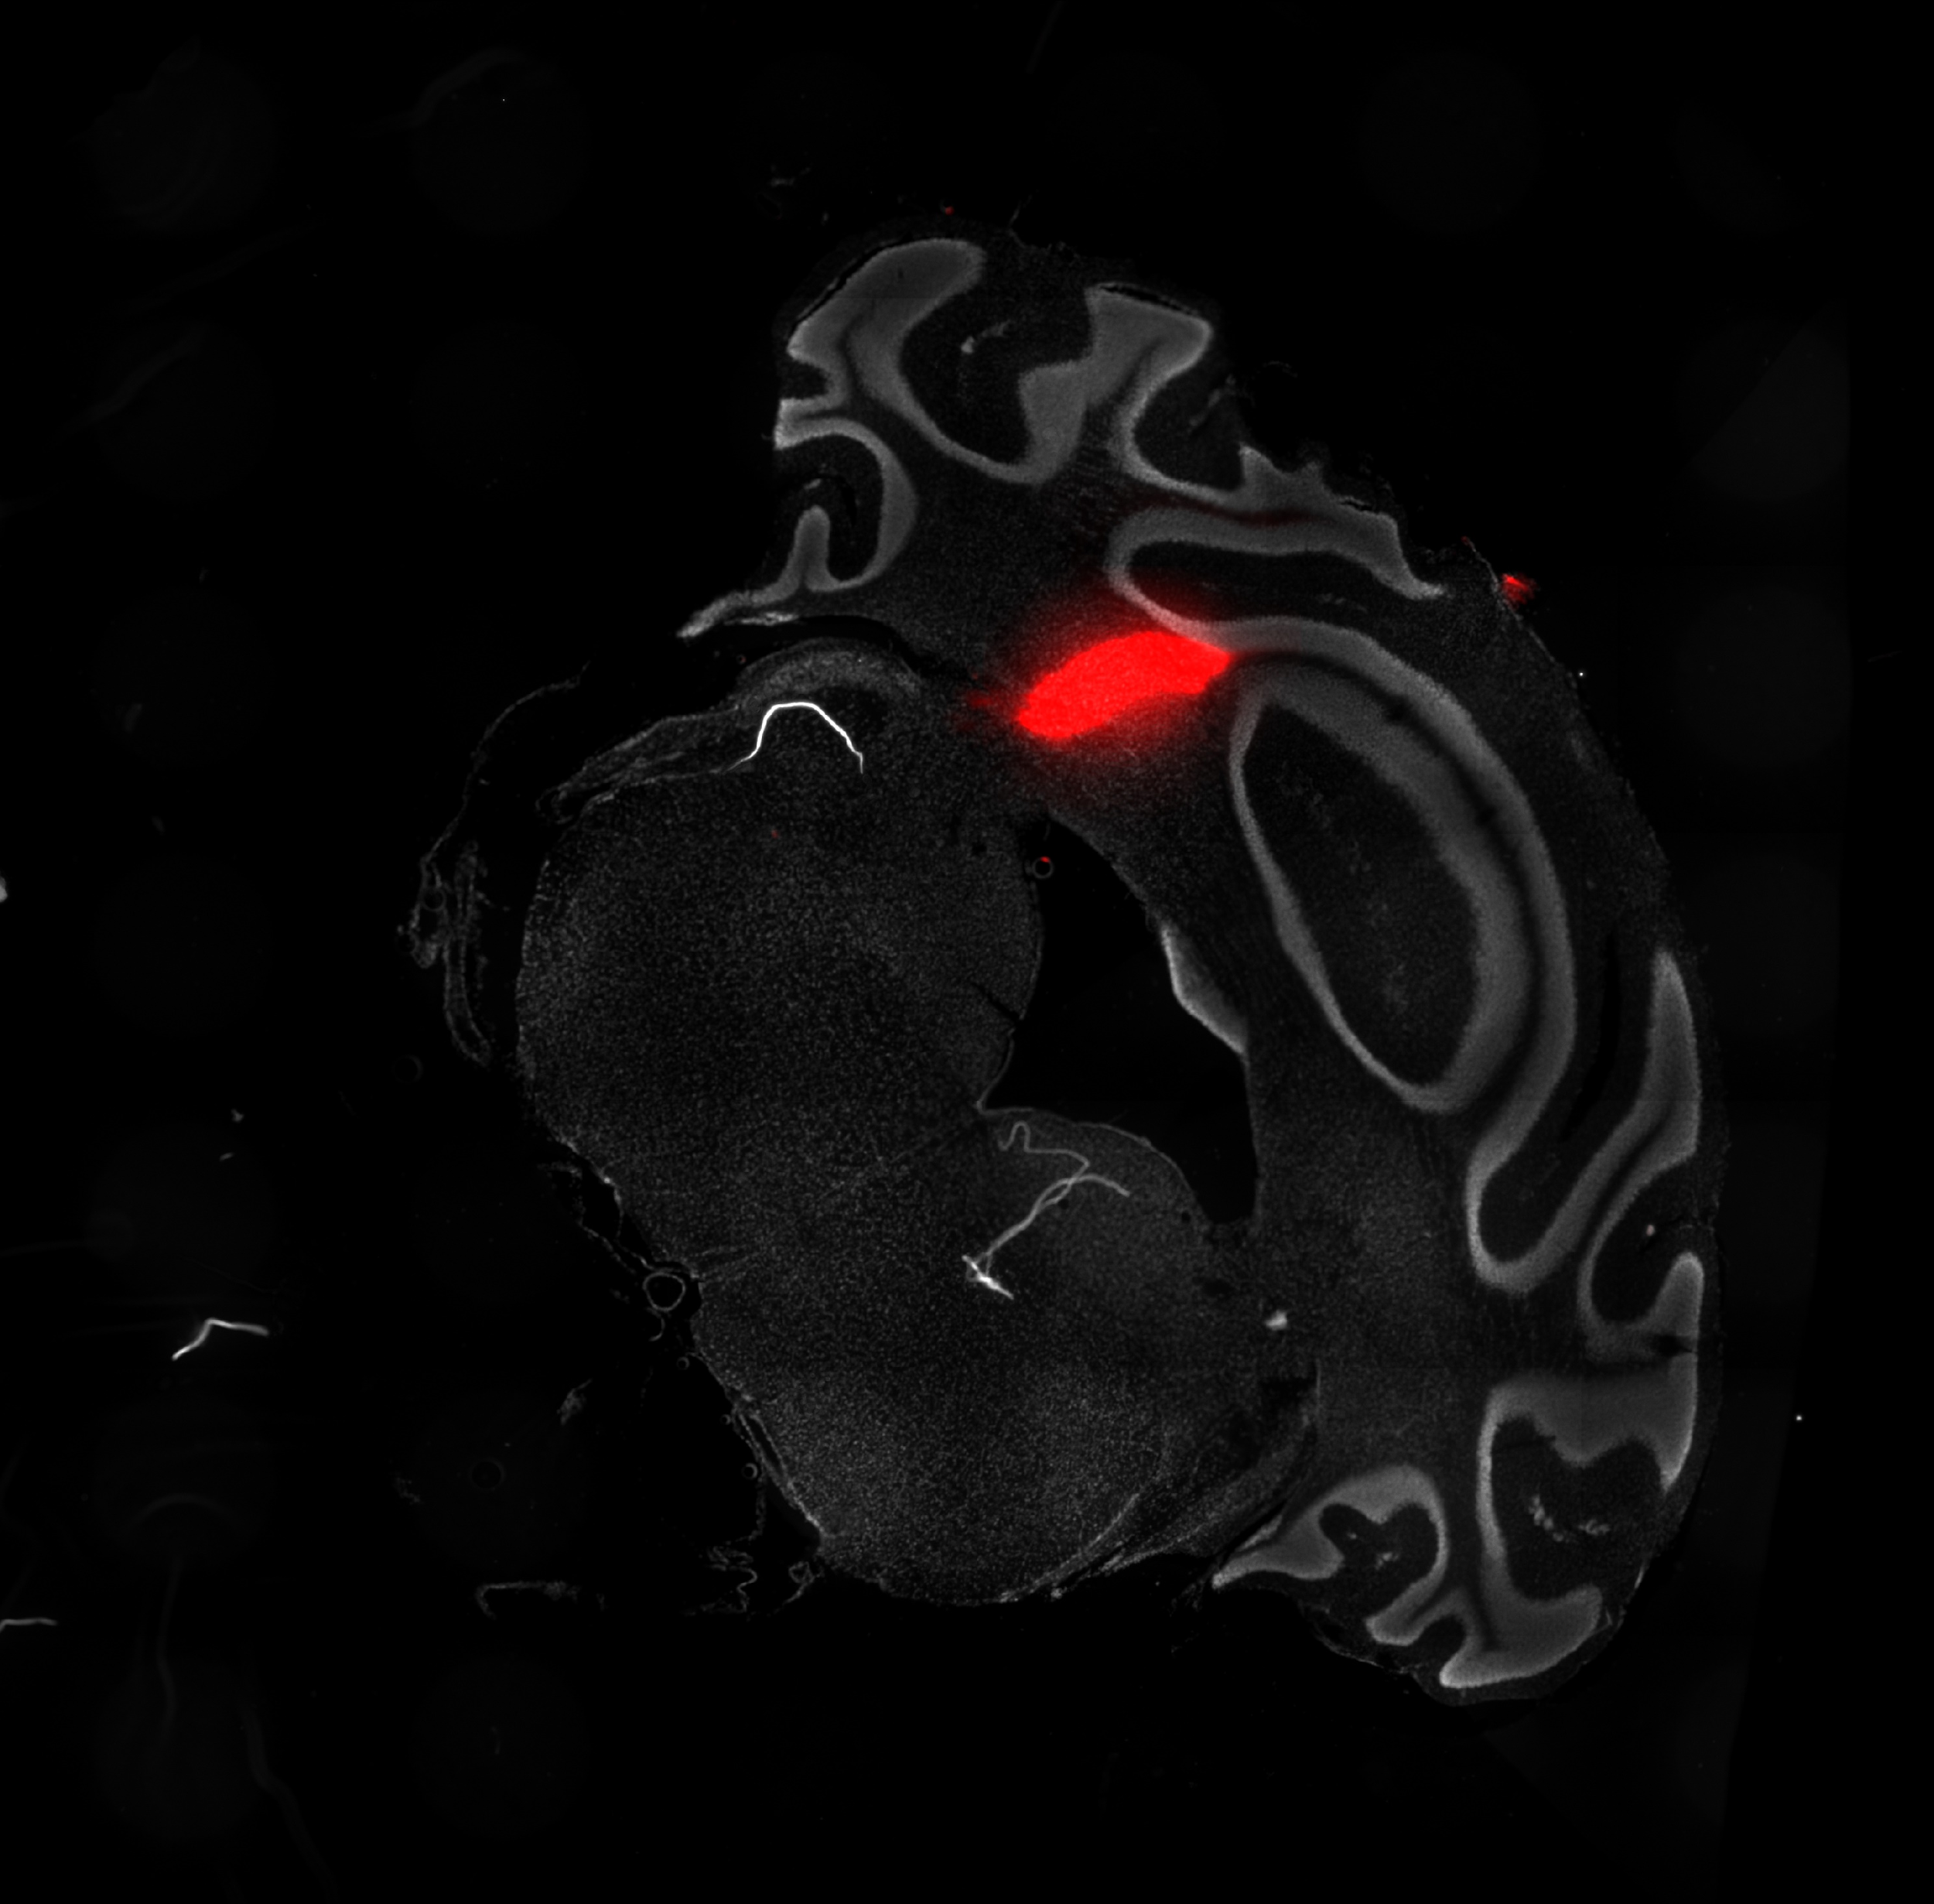
Confirmation of electrode location
- Coat probe with fluorescent-dye
- Fluorescence microscopy
Figure 11: Conformation of probe location using CM-DIL with DAPI as counterstain 50x

Slide 15
Hypothesis
- Wt-type mice show a neuronal response to the CS in anticipation of the US
- The DCN contains
- Neurons in the DCN in Shank2-/- show impaired response to the CS in anticipation of the US

Slide 16
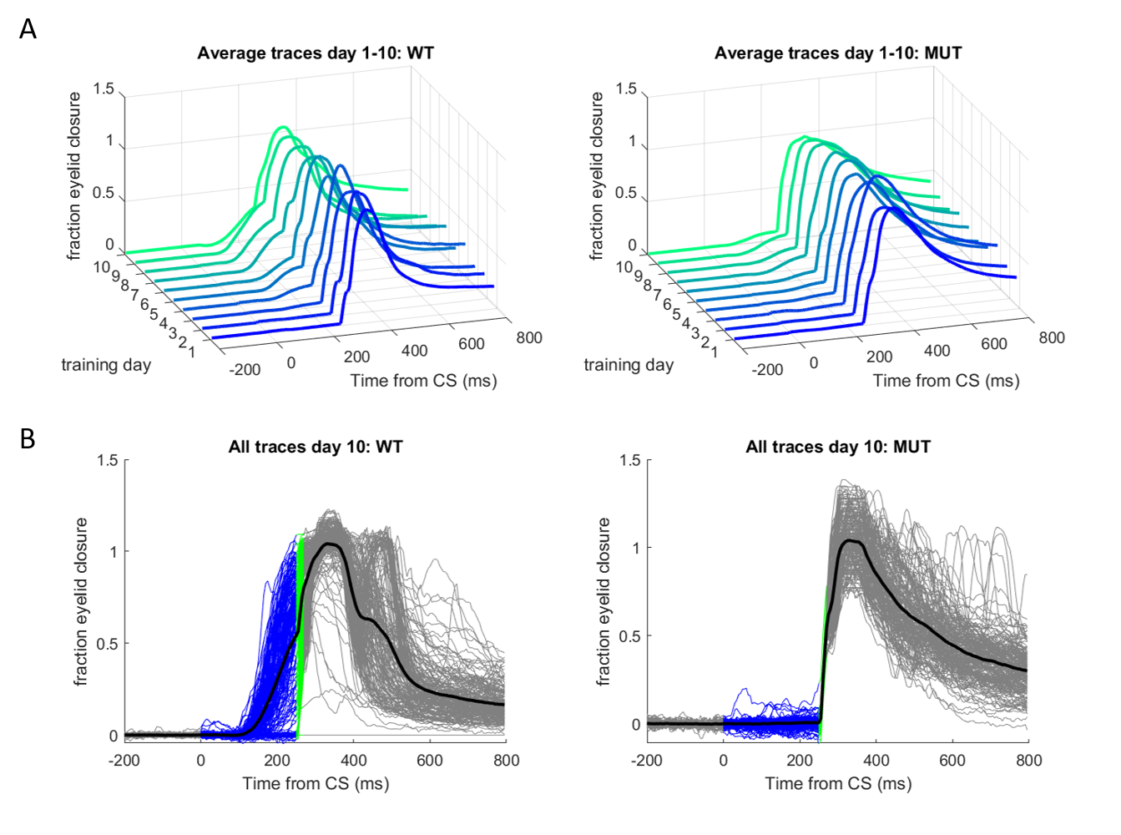
Shank2^{-/-} mice show a clear learning deficit in eyeblink conditioning
Figure 5: Shank2^{-/-}(n=8) show a learning deficit compared to wild-type mice(n=8) in eye blink condition

Slide 17
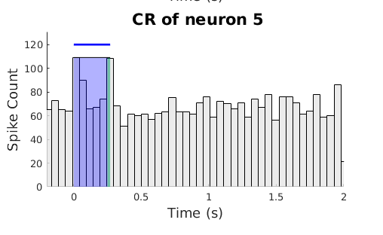
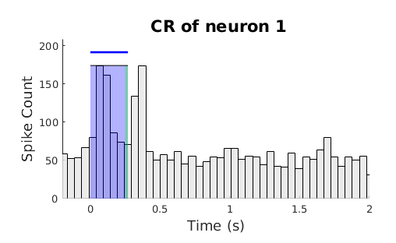
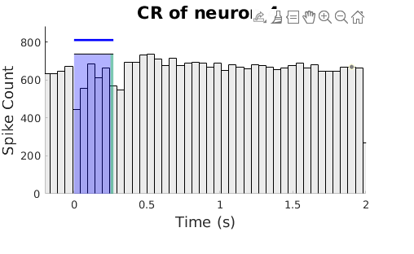
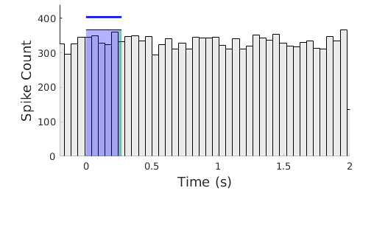

Slide 20
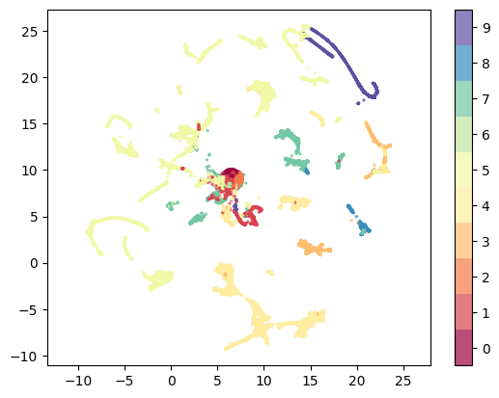

Slide 21
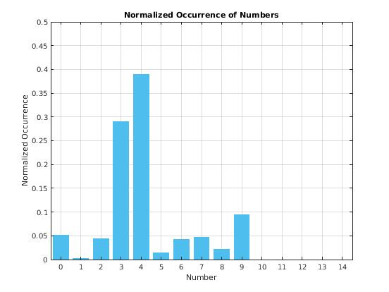
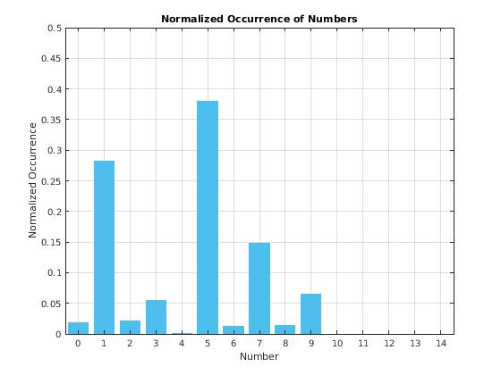
Behaviour eyeblink conditioning

