Slide 1
Strategic risk leadership and sustainability
University of Katowice – Inholland University of Applied Sciences
Linda Snippe MSc. CBM
March 2023

Slide 2
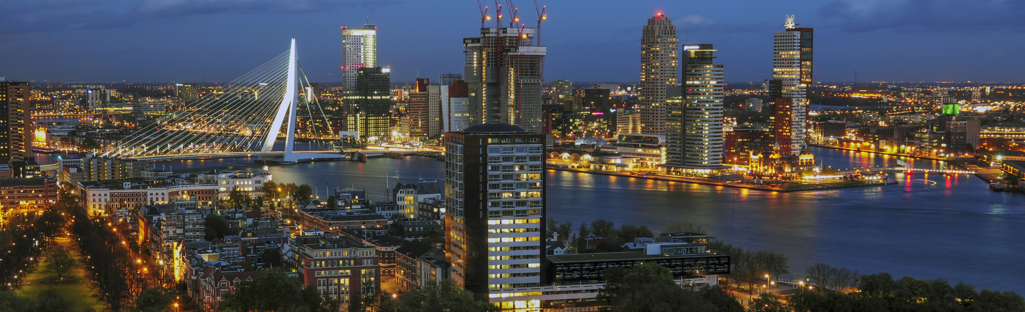
Inholland University of Applied Sciences
7 locations in the western part of The Netherlands
25.000 students
I’m working in Rotterdam on the faculty Business, Finance & Law

Slide 3
Introduce myself: Linda Snippe MSc. CBM
Researcher and lecturer Finance & Control, Inholland Involved in several research projects, such as:
Sustainable Performance & Risk Management
From crisis management to risk management in the agricultural sector
Literature study Key variables for transition path circular greenport
Chairman of Supervisory board, De Hoeksche School
Primary and secundairy education, 25 schools, 550 FTE.
Member of Supervisory board, chairman of audit commitee, Onderwijsgroep Galilei
Secundairy education, 6 schools, 500 FTE.

Slide 4
Strategic risk leadership: The “problem”
It was revealed that research on sustainable development seems to have underestimated the role of responsible leadership in embedding a risk culture that underpins sustainable innovation. Responsible leaders can establish and maintain a risk culture that promotes sustainable innovation (Chukwudum & Fragouli, 2019)
Traditional performance and risk management is not a guarantee that an organization will survive, through the remaining residual risks, including the “megatrends” in a VUCA world.
Notes:
*Megatrends are strong social, demographic, environmental and technological forces that are profoundly changing our world, for example climate change

Slide 5
Gap in existing literature
Little is known about collective (inter-personal) behavioral dynamics, as well as the determinants and the limitations relevant for effective risk resilience. In this regard, it is desirable that studies on risk and risk management go beyond the traditional management, finance and/or accounting perspectives to include the behavioral perspective as well (Florio, 2022).
Miller et al. (2018) mention strategic leadership, contextual awareness and organizational development as examples of VUCA driven management innovation clusters to focus research on.

Slide 6
The purpose of this study
Analyzing the relationship between sustainable performance and risk management, whereby sustainability, interdisciplinairity and leadership give new insights to the traditional perspectives on performance and risk management in the field of accounting and finance.

Slide 7
Research question
“How to use risk management in an ever-changing environment?”
Notes:
It has been studied by literature review and empirical research, using 51 unique cases.

Slide 8
Conceptual model
Notes:
Assuming that…
Part 1:
Part 2:

Slide 9
Conclusions literature research
Risk management in an ever-changing environment consists of:
Risk leadership (clear sighted, proactive, inclusive, and respond decisively),
For agile organizations with clear and transparent organizational goals, and a
Dynamic model of the world, whereby visions and strategies are always in flux to adapt to this changing world.
In a resilient organization, risks are handled due to a holistic view, where the organization is part of a system consisting all disciplines. With strategic planning, in interaction with chain partners and the area where the organization is involved, future scenario’s arise. It’s about creating awareness and adaptiveness to create an sustainable organization.

Slide 10
Conclusions empirical study
In the results of part 1 of the empirical research, it has been founded that sustainability is not congruent in mission and vision with the strategy and core values, and related to sustainability strategies and pursuing SDGs. That means that: organizations do have the ambition to be sustainable, but do not yet have sufficient concrete direction on it, and; organizations have no intention of being sustainable and at the same time in many cases steers towards sustainable policy.
In the results of part 2 of the empirical research, it has been founded that in all sustainability strategies there are organizations (11-28%) that do not have any sustainability criteria in the mission/vision, strategic goals, and core values. On the other side, from the organizations that do not follow a sustainability strategy, 44% of them shows sustainability criteria in mission/vision, strategic goals and/or core values. Same as in part 1, part 2 shows incongruence in mission/vision with managing the organisation for sustainability strategies.

Slide 12
Q1: Performance management is oriented towards achieving objectives. (other wrong answers: the result an organization shows; information management in regard of activities

Slide 13
Q2: Risk management is focused on maintaining performance when risks arise. (all answers right: starts with identifying and evaluating risks; ….

Slide 14
VUCA world
The four factors are fed daily by numerous developments on a global, national, or local scale. Developments that continuously and mutually influence each other, in ways that we can never fully understand (Van Staveren, 2020).
Q3: have you ever heard from the concept of VUCA?

Slide 15
Q4: What does leadership consist of in a VUCA world?
Add some examples, characteristics

Slide 16
Leadership in a VUCA-world needs to adapt to the four VUCA factors in several aspects. For example, you need a dynamic model of the world. This means visions and strategies are always in flux to adapt to this changing world. You can no longer offer security (Ducheyne, 2016).
This increases your dependence on others. You need creativity from inside and outside the organization to successfully achieve goals in a VUCA environment (Van Staveren, 2020).

Slide 17
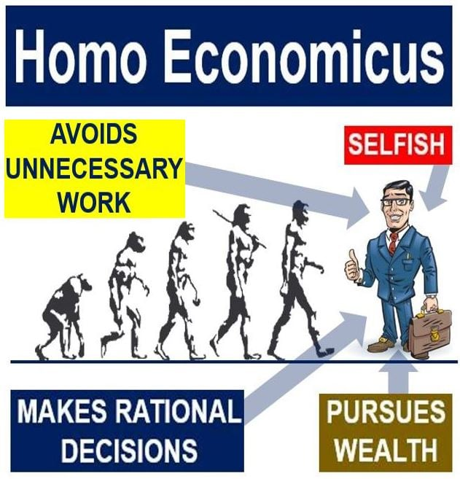
How we were raised up…
Risk management
provides organizations with the tools and processes to identify changes and threats in a timely manner and choose the right strategy to deal with them. (Janicijevic & Claes, 2021). Seeing through and analyzing significant changes in time determines continuity and results.
Q5: do you think the world still works like this?

Slide 18
To become more sustainable
To become more sustainable in thinking and acting, we need a new perspective.
Recently, the homo florens is formulated as:
“This person is focused on lasting relationships and finds satisfaction in the well-being of others and themselves. This image of humanity can support students in Higher Economic Education during their careers to contribute to the transition to a sustainable, inclusive and humane economy.”

Slide 19
Navigating skills for a VUCA world Qx.
(Bartelts & Snippe, 2022)

Slide 20
Who is the winner?

