Slide 1
Marco Romagna -Lecturer The Hague University of Applied Sciences -PhD candidate Leiden University
What motivated me was seeing a corrupt capitalistic world around me, the greed and lack of generosity that permeates the world is appalling and is the negation that drives many of us to want answers for ourselves and answers to give the uninformed public. This corrupt vulnerable system we want patched. We also see denying a monolithic corporation or government's servers connection to the internet as a form of power that promotes power to the people as a non-violent protest, a deliberate attack to elitism/fascism. I identify as an individual that uses "methods" to be a voice for the voiceless and to bring justice to those who have received none.
BECOMING A HACKTIVIST
Examining the motivations and the processes that prompt an individual to engage in hacktivism
NVC 2022
17th June
Notes:
What are the motivations and the processes that prompt a person to engage in hacktivism and to what extent are they like traditional forms of social protest?

Slide 2
SOCIAL IDENTITY MODEL OF COLLECTIVE ACTION (SIMCA)
GROUP-BASED ANGER
(Violated) MORAL VALUES
COLLECTIVE ACTION
(Politicized) SOCIAL IDENTITY
GROUP EFFICACY

Slide 3
METHODOLOGY
CONTACT
Response rate 26% (30/115)
Criteria to select participants
(15) (6) (4) (3)
INTERVIEW
Collection 02-2017 > 12-2021
(9) (8) (6) (4) (1)
Interview protocol based on SIMCA

Slide 4
MORALITY
Fighting crime / evil / terrorism
21/28
Patriotism 9/28
Exposing political / elite misconducts
18/28
Animal rights / environment
5/28
Notes:
-Starting point for each action
-4 categories
a) Fighting crime/evil/terrorism (21/28)
b) Exposing political/elite misconduct (18/28)
c) Patriotism (9/28)
d) Animal rights/environment (5/28)
-17/28 respondents stood up for 3 causes while 11/28 only for 1
- Patriotic hacktivists never mentioned animal rights/envir. as a cause to hack

Slide 5
SOCIAL IDENTITY
“[There is] no doubt that sharing the values, the morals and the ideas plays a big role in my involvement, especially where I am participating in a specific OP that we agreed on initiating.” (R28)
Notes:
- Identification with disadvantage group or supporting a group they did not belong to
Social identity as the second step of involvement (SIMCA) in 14/28
First time hacktivism
- Social identity (group identification) 14 > perceived injustice 12/14

Slide 6
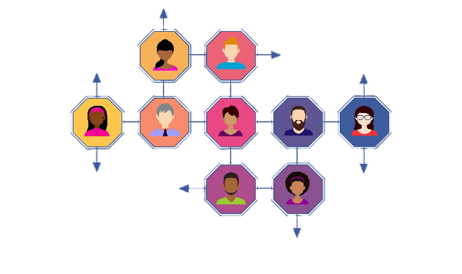
SOCIAL IDENTITY
Social identity
Collective identity
Personal identity
Notes:
- Identification with disadvantage group or supporting a group they did not belong to was present in 27/28
First time hacktivism
- Social identity (group identification) 14 > perceived injustice 12/14

Slide 7
PERCEIVED INJUSTICE
“This sense of deprivation makes me aggressive sometimes.” (R16)
“Frustration is normally a pretty key factor [to act].” (R18)
Notes:
- Identification with disadvantage group or supporting a group they did not belong to
Social identity as the second step of involvement (SIMCA) in 14/28
First time hacktivism
- Social identity (group identification) 14 > perceived injustice 12/14

Slide 8
PERCEIVED INJUSTICE
ANGER
Political actions 16/22
Social disparities 10/22
Race / ethnicity / patriotism
7/22
Notes:
Perceived injustice mentioned in 22 interviews
- Political actions 16/22
- Race/ethnicity/patriotism 10/22
- Social disparities 7/22
First time hacktivism
- Perceived injustice 9 > perceived efficacy 7/9

Slide 9
PERCEIVED EFFICACY
“With all the knowledge and skills that I gained over the years […], I redirected them all for hacktivism and activism and became Anonymous. […] I felt faster online to spread my message and show it, also influenced media to talk about it.
And what I mean by this is hacking.” (R24)
Notes:
- Identification with disadvantage group or supporting a group they did not belong to
Social identity as the second step of involvement (SIMCA) in 14/28
First time hacktivism
- Social identity (group identification) 14 > perceived injustice 12/14

Slide 10
PERCEIVED EFFICACY
Desire to change something
Perceived self efficacy
Group efficacy
Notes:
PE is normally the last step of the collective action process
Group efficacy is present in 22/28 interviews, often regarded as an added value
First time hacktivism
- Perceived efficacy 5 > social identity 5/5

Slide 11
ENGAGEMENT PROCESS
(Violated) Moral values
Fundamental first step for action
Social identity
Bridge function
Perceived injustice
Anger as a form of booster
Perceived efficacy
Final rational approach
Social Identity Model of Collective Action (SIMCA)
Notes:
Group identification is followed by perceived injustice in 13/24 cases
Perceived injustice/anger is followed by perceived efficacy in 19/28 cases (the opposite happens 3/28)

Slide 12
Marco Romagna -Lecturer The Hague University of Applied Sciences -PhD candidate Leiden University m.romagna@hhs.nl @PHacktivism @MarcoRomagna86
BECOMING A HACKTIVIST
Examining the motivations and the processes that prompt an individual to engage in hacktivism
NVC 2022
17th June

