Slide 1
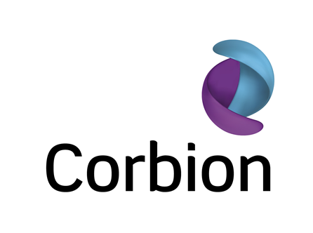
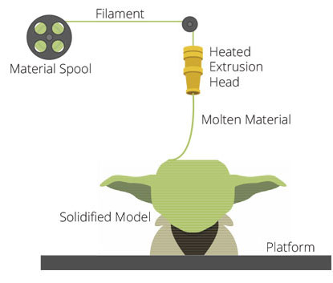
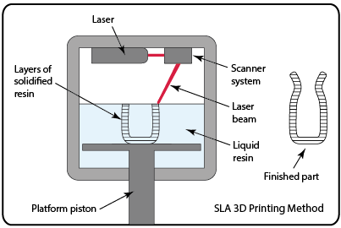
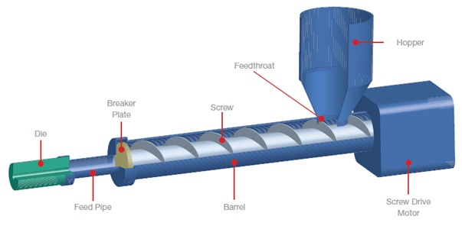
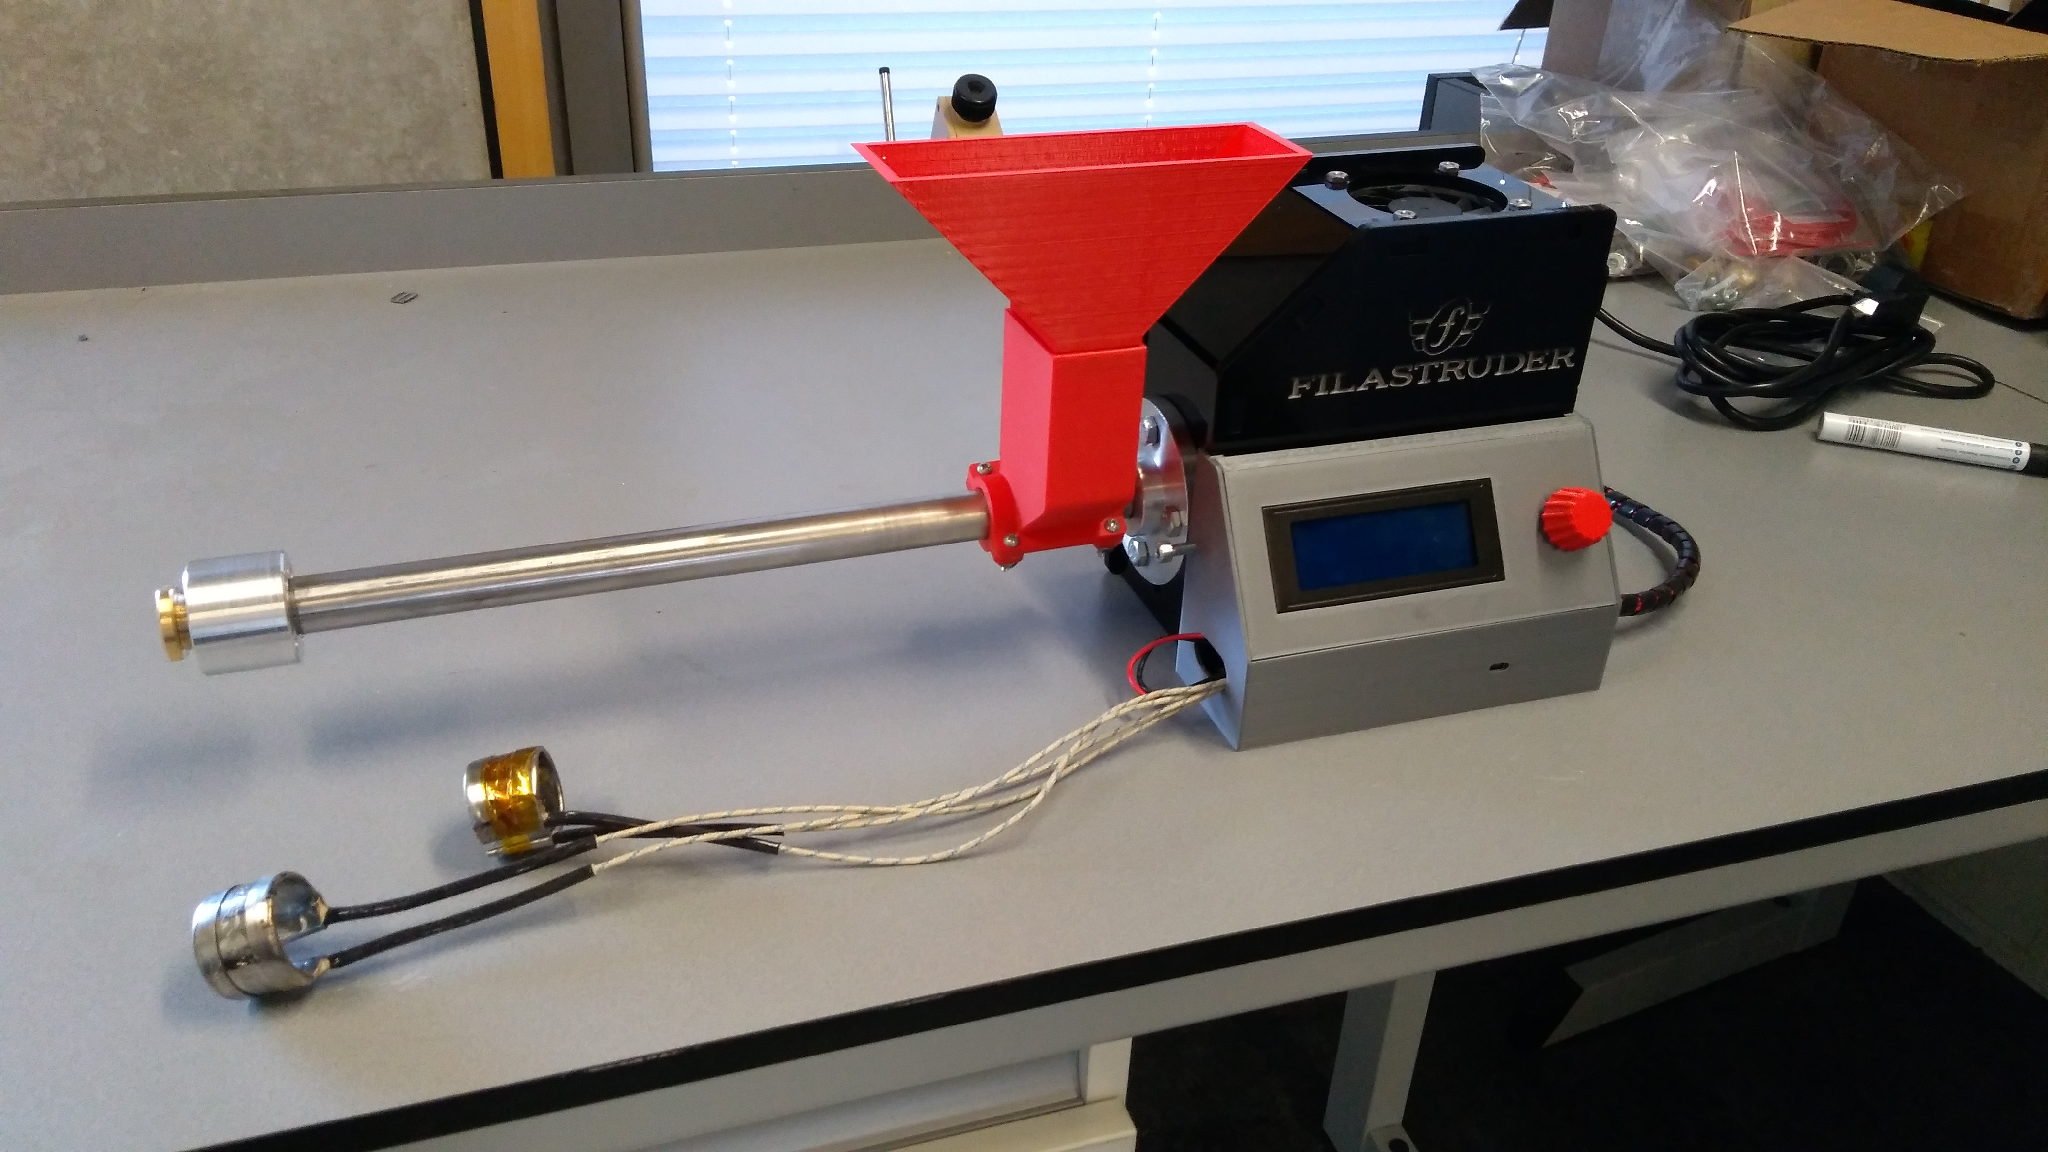
3D print applications for Biomedical Technology
Mark Leemhuis ^{a,c} , Sara Panahkhahi ^{b,c}, Erwin de Vlugt ^{c}
ª Process & Food Technology,^{b} Mechanical Engineering, ^{c} Technology for Health
Projects in cooperation with:
Background
3D printing (Additive Manufacturing, AM) is rapidly becoming a commodity nowadays. With the expansion of available techniques also the amount of applications increases rapidly. Relatively new is the application of AM in the medical and pharmaceutical fields.
Application of AM in these areas requires the used polymeric materials to be biocompatible and ideally also biodegradable.
Knowledge of the behaviour of these materials as well as their processability is crucial to allow development of new materials with tailored characteristics. Most commonly FDM printing and Stereolithography is used in medical applications.
A B
Schematic representation of FDM printing (A) and SLS printing (B)
Aims
Combine existing materials to create blends with new characteristics
Make new materials with tailored characteristics
Investigate print techniques and make appropriate materials
Develop new processing methods and improve existing ones
Methods
Making blends of varying composition
Chemical synthesis of new polymeric materials
Chemical and physical analysis and data collection
Extrusion to obtain FDM filament
Resin production for use in stereolithography (SLS)
In the curriculum
Students are encouraged to participate in ongoing applied research in several ways.
Projects (semester or block)
Company projects (specialization phase)
(graduation) internships
Topics like research methods, design of experiments, data analysis and more specialized theory can be offered to the students.
Current projects
Artificial muscles (cooperation with TUDelft)
Materials with improved heat conduction
A model of a Nylon muscle
(Thesis Bas vd Berg, THUAS 2017 &
Thesis Ke Wang, THUAS 2018)
Making polymeric blends of biocompatible and biodegradable polymers for extrusion into FDM filament (cooperation with 3D4Makers)
Test prints of 100% polyglycolic acid (left, internship report Andres Bejarano Portela, THUAS 2018) and a blend of 25% polyglycolic acid/75% polylactic acid (right, internship report Diana Ergle, THUAS 2018)
Design and synthesis of resins that can be used in SLS fabrication of biodegradable cardiovascular stents (Cooperation with TUDelft and Corbion)
Materials need to be photosensitive, biodegradable and biocompatible
Schematic representation of a design cycle for cardiovascular stents. Taken with permission from J. Fajardo Cortes, Master Thesis TUD, 2017.
Outlook
Develop Biomaterials minor
Continue to expand cooperations with other universities and companies
Continue to offer internships and projects to students
Schematic representation of polymer extruder (left) and PFT lab extruder (right) designed and built by Ake Blom, Erik Franke, Jimmy Dost and Marlo Verboom, internship THUAS 2018.

