Slide 1
FUTURE SKILLS: AND where to find them?
Masha Ovtchinnikova
Adviser innovation and digitalization in education

Slide 2
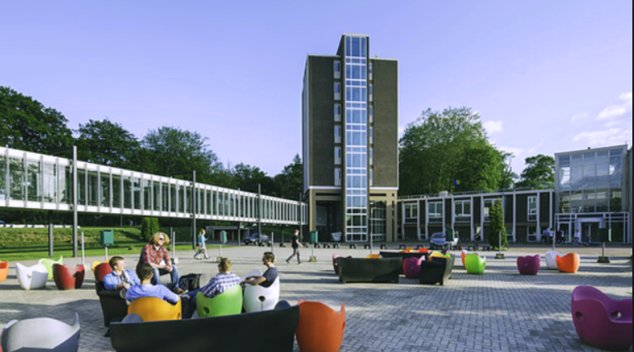
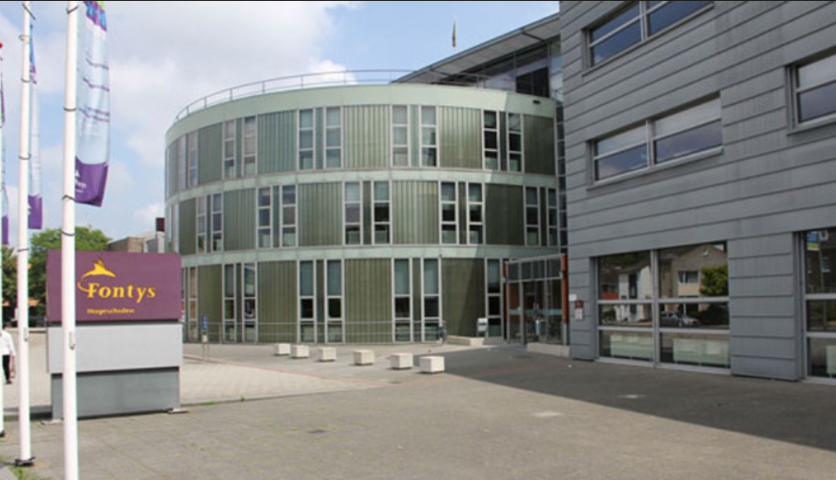
Fontys curriculum vitae
Knowledge institute with centres in Eindhoven, Tilburg, Venlo and Sittard
More than 4500 employees and more than 44.000 students
29 institutes provide 85 Bachelor curricula, in full time, part time and dual in almost all sectors of society
22 Master’s course and 8 Associate degrees
41 Lectureship connected to research and knowledge innovation

Slide 3
TEC for Society
Brainport region
Social responsible innovation
Fontys solution
Notes:
TEC for Society als zwaartepunt van Fontys en TEC-skills als meer concrete uitwerking voor het onderwijs zijn holistische concepten. De betekenis ervan is meer dan de optelling van de betekenis van de afzonderlijke onderdelen, het gaat om de samenhang en interactie ertussen. Toch kiezen we er in dit stuk voor om elk aspect afzonderlijk te beschrijven, in de literatuur worden ze ook onderscheiden. In de beschrijving van elk aspect is de samenhang met andere aspecten zichtbaar. Deze begripsverkenning is gericht op de onderbouwing van de relevantie van de betreffende skills en het schetsen van de skill-sets die uit de literatuur bekend zijn op het terrein van Technology, Entrepreneurship en Creativity. De schets is zeker niet uitputtend of definitief maar is bedoeld ter inspiratie en geschikt voor verdere uitwerking en onderbouwing in samenwerking met de Fontyspraktijk. Daarna zoomen we in het document in op het uitgangspunt dat TEC-skills altijd ontwikkeld worden in de context van actuele en vaak complexe vraagstukken uit de praktijk (for Society). We besluiten het stuk met een beschrijving van het vervolgproces.

Slide 4
MindLabs als example
https://player.vimeo.com/video/233682982?color=b06112&title=0&byline=0&portrait=0

Slide 5
AI in education
Multidisciplinary
Student participation
Professional practice
Contribution to region society

Slide 6
AI in education
Can we trace creativity in text and can we make a prediction how to improve it?

Slide 7
AI in education
Creativity from cognitive psychology perspective
Natural Language Processing
Statistical prediction

Slide 8
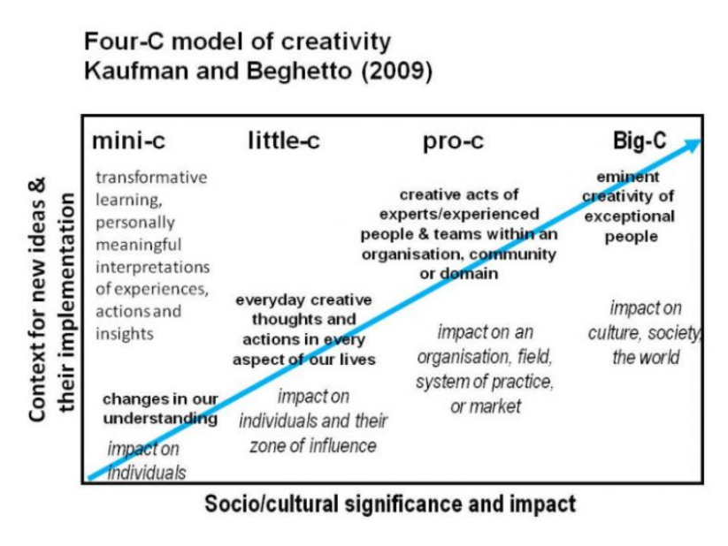
AI in education: Creativity from cognitive psychology perspective
“the ability to produce work that is both novel (i.e. original, unexpected) and appropriate (i.e., useful, adaptive concerning task constrains)”
Sternberg & Lubart, 1999
Notes:
Levels of the Four C Model of Creativity
The mini-c level of creativity Creativity is inherent in learning. Any time one attempts a new task, there is a level of creativity involved. At the mini-c level of creativity, what one creates might not be revolutionary but it is new and meaningful to them. Example: Jacob brings home his first painting from school. It is his first attempt to be appropriate to the task and it is new and meaningful to him.
The little-c level of creativity The little-c level of creativity reflects an aspect of growth from the mini-c level. With appropriate feedback, advancements are made and what was created might be of value to others. Example: Jacob’s parents love the new painting Jacob brought home today. They place it on the refrigerator because they think it is good and they get enjoyment out of seeing it. It’s on its way to becoming art.
The Pro-c level of creativity At this level, one has the ability to be creative at a professional level and in a professional venue. At this point, one would have had many years of deliberate practice and training. Not everyone at the Pro-c level can make a living with their creative pursuit; however, it is generally the goal of those at this level to support themselves doing something they love. Example: Jacob majored in art in college and his pictures now hang in galleries. His paintings are recognized by art experts and critics as being creative. His paintings hang in the homes of others—not just his friends and family, but people who do not know Jacob personally but who appreciate and are moved by his art.
The Big-C level of creativity Those at the Big-C level will be remembered in the history books. The Big-C level includes an evaluation of one’s entire career and entire body of work and then evaluates the entire body of work against other great contributors and decides where one fits in. Example: Over the years, Jacob’s paintings have been bought by people who have tremendous collections of artwork. His paintings hang in famous galleries and are regularly discussed by experts. Decades from now, Jacob will be considered one of the greatest artists of all time.

Slide 9
Creativity from cognitive psychology perspective
“creativity is the ability to solve problems or fashion product to rise new questions”
Gardner, 1997

Slide 10
Creativity from cognitive psychology perspective
Measurement of creativity:
Model of Guilford
Taxonomy of creative design by Nilsson
Notes:
De psycholoog J.P.Guilford richt zich met zijn onderzoek en model vooral op divergent denken. Volgens hem is dit goed meetbaar, en kunnen leerlingen (en docenten ook natuurlijk!) zich verbeteren op de verschillende onderdelen door veel te oefenen. Zijn methode van creativiteit meten gaat uit van vier verschillende punten:
Originaliteit en fantasie (gekke, rare, unieke ideeën)
Vlotheid (de hoeveelheid ideeën in een bepaalde tijd)
Flexibiliteit (hoe makkelijk je van ‘plan’ kan veranderen)
Complexiteit (de hoeveelheid details, het herkennen van patronen
Dit geeft ook meteen de zwakte aan van de test: het zegt niets over de relevantie of waarde van wat er gemaakt is.
Zoals te zien is in de afbeelding gaat Nilsson hierbij uit van 5 verschillende punten:
Imitatie: Het ontwerp is hetzelfde als iets wat al bestaat.
Variatie: Er is een kleine verandering in het ontwerp, maar is het nog steeds duidelijk waar het ontwerp op gebaseerd is.
Combinatie: Het ontwerp is een combinatie van twee of meerdere andere dingen, zodat je kunt zeggen dat het iets nieuws is maar wel duidelijk gebaseerd op andere werken.
Transformatie: Het is een nieuwe creatie, met elementen van ander werk maar wel origineel genoeg om op zichzelf te kunnen staan.
Originele creatie: Het ontwerp is uniek en staat compleet op zichzelf. Het heeft nauwelijks tot geen verbanden met wat er al eerder gemaakt is.

Slide 11
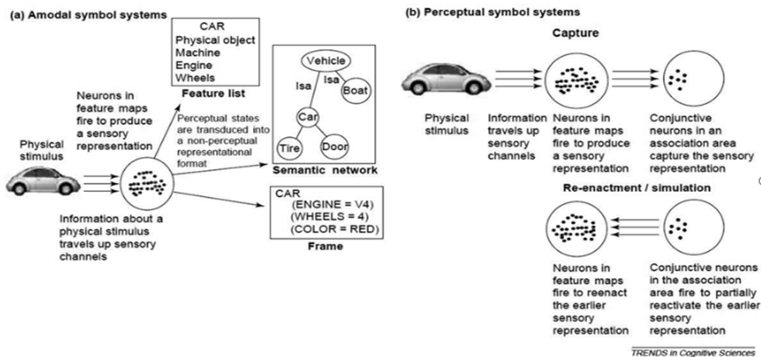
AI in education Natural Language Processing
Barsalou, Simmon, Barbey, and Wilson, 2003
Notes:
In the field of Communication and Information science one of the important questions is how people extract a meaning of the words? Is our brain a computer, which calculates the meaning of a word from associations and concepts, like the word car associated with concepts of vehicle, engine, wheels, red colour? Or the corn of meaning lays in activation of perceptual and physical experiences? For example, the meaning of word car comes from the activation of perceptual experiences with movement, smell of petrol, object of adoration and care. Or it is both? Like prof. dr. Max Louwerse suggested in his hypothesis of Symbol Interdependency.
Figure 1.Barsalou, L. W., Simmons, W. K., Barbey, A., and Wilson, C. D. (2003). Grounding conceptual knowledge in modality-specific systems. Trends in Cognitive Sciences, 7, 84–91

Slide 12
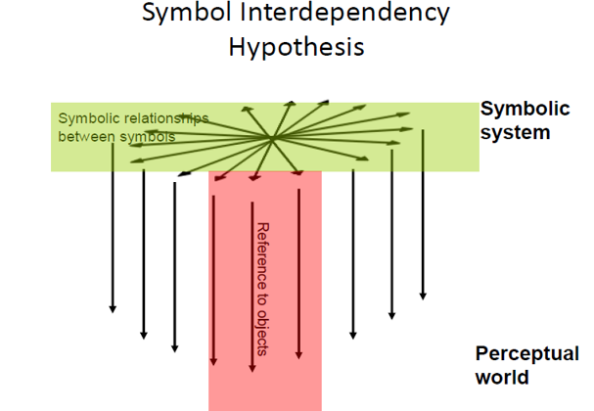
AI in education
Louwerse, 2011
Notes:
According to this hypothesis language comprehension can come from calculations by our brain of interdependencies of word associations and concepts, but also from how these words refer to our representations of the real world. It also means that language encodes structures of the world around us and language users use these structures in the comprehension process. But how this interdependency works? So, look in this way. If the language encodes the structure of the real world, than is a hast to be possible also to decode it.

Slide 13
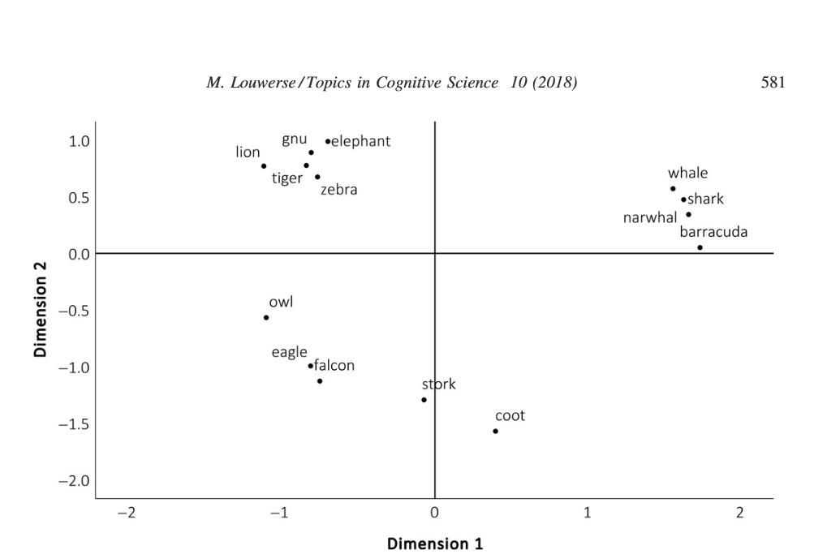
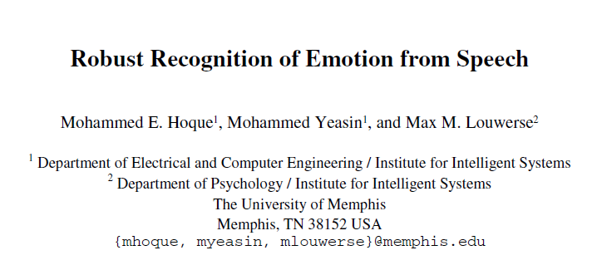
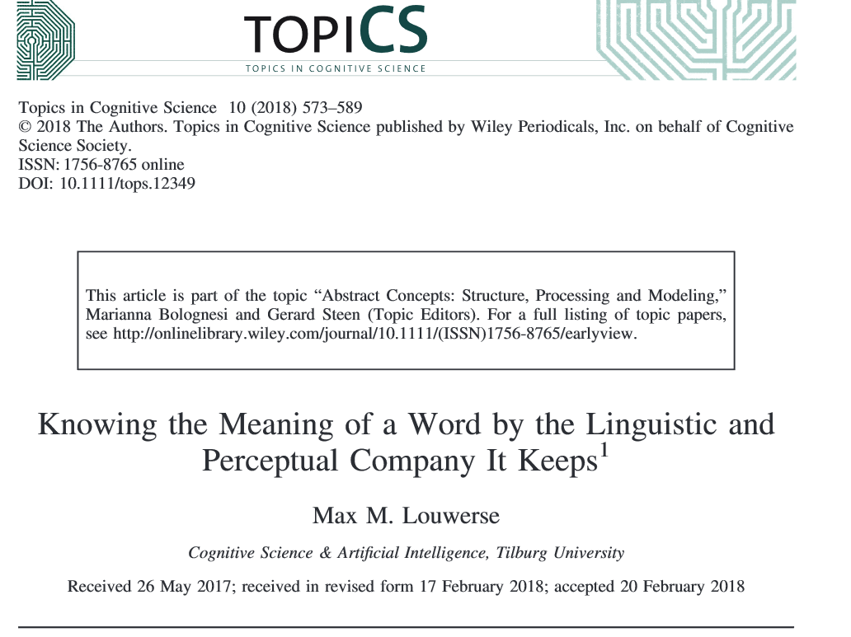
AI in education
Notes:
Limited grounding of a word to its referent allows for distributing meaning across a network of linguistically related words. Each of these words could be individually grounded, but it does not have to
be when semantic approximations suffice. These semantic approximations provide good-enough representations (Ferreira, Ferraro, & Bailey, 2002).
This paper presents robust recognition of a subset of emotions by
animated agents from salient spoken words. To develop and evaluate the model
for each emotion from the chosen subset, both the prosodic and acoustic
features were used to extract the intonational patterns and correlates of emotion
from speech samples. The computed features were projected using a
combination of linear projection techniques for compact and clustered
representation of features. The projected features were used to build models of
emotions using a set of classifiers organized in hierarchical fashion. The
performances of the models were obtained using number of classifiers from the
WEKA machine learning toolbox. Empirical analysis indicated that the lexical
information computed from both the prosodic and acoustic features at word
level yielded robust classification of emotions.
Fig. 1 is generated from a two-dimensional plotting of the coordinates that were
retrieved from a matrix of Latent Semantic Analysis (LSA) cosine values. These cosine
values represent the semantic similarities between the words as computed by LSA, an
algorithm that computes semantic contiguity based on higher-order co-occurrences of
these words in their linguistic context

Slide 14
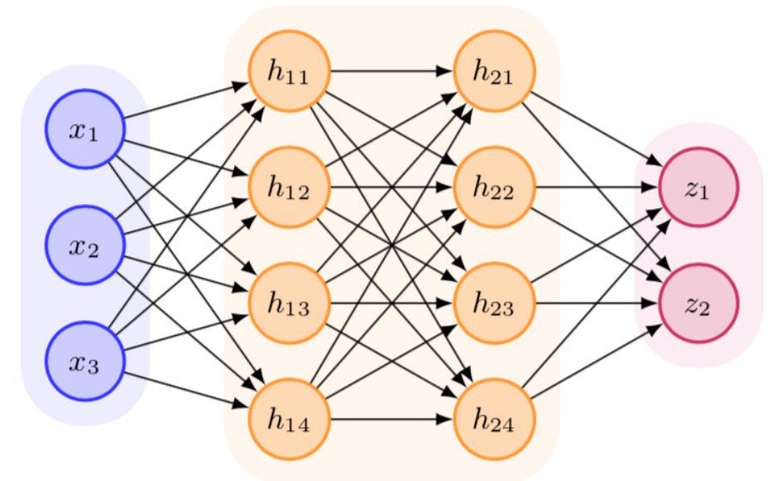
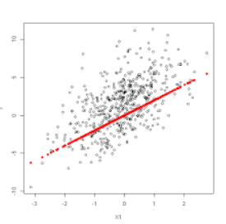
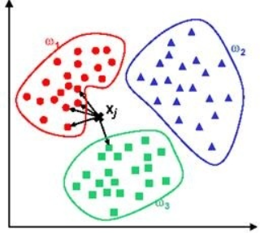
AI in education Statistical prediction
Naive Bayes classifier
k-nearest neighbor algorithm
Generalized additive model
Notes:
Neural Netwerk:An artificial neural network is an interconnected group of nodes, akin to the vast network of neurons in a brain. Here, each circular node represents an artificial neuron and an arrow represents a connection from the output of one artificial neuron to the input of another.

Slide 15
AI in education

